Slide 1
THE POWERHOUSE OF ENTERTAINMENT

Slide 2
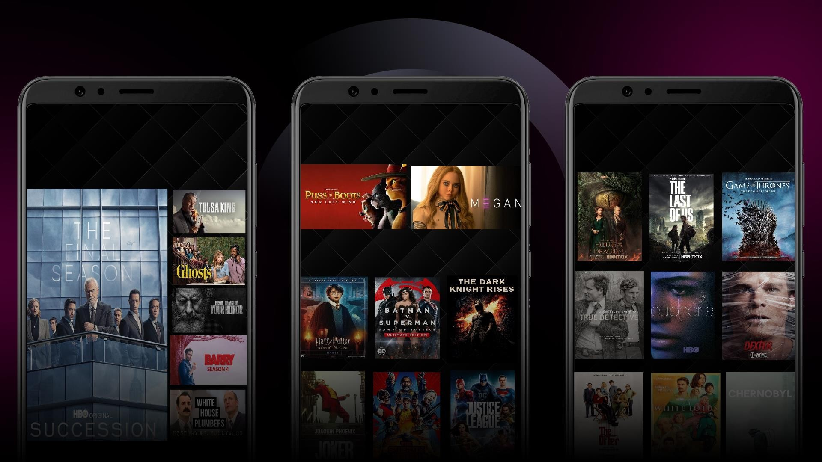
COMING ON MAY 12
BLOCKBUSTER MOVIE PREMIERES
PREMIUM INTERNATIONAL SERIES
SERIES/SEASON PREMIERES
BLOCKBUSTER MOVIES

Slide 3
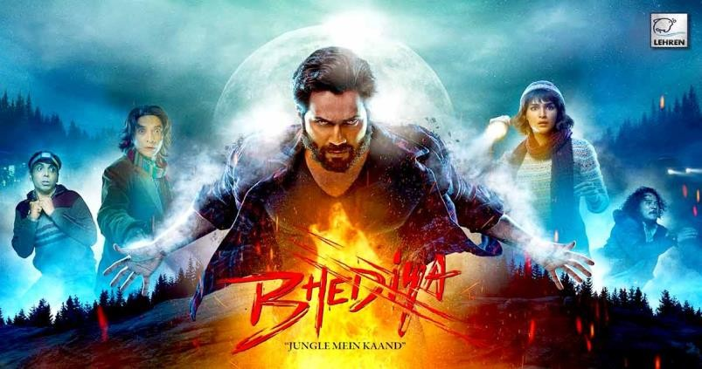
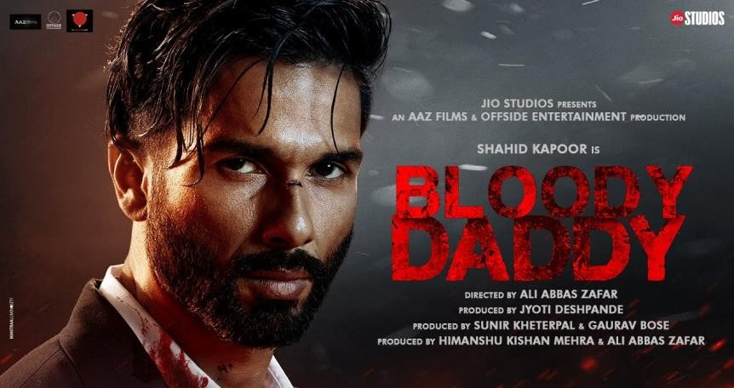
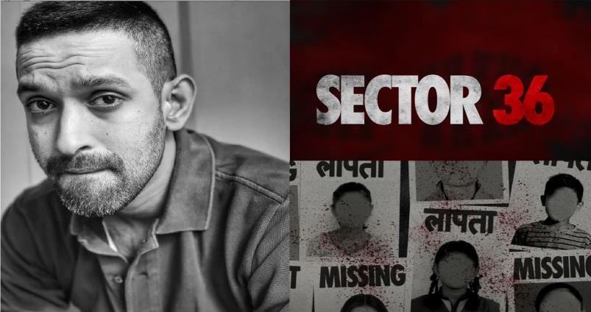
BLOCKBUSTER MEGA MOVIE RELEASES EVERY MONTH
Launch: 12th MAY
Launch: MAY
Launch: JUNE
Launch: JULY

Slide 4
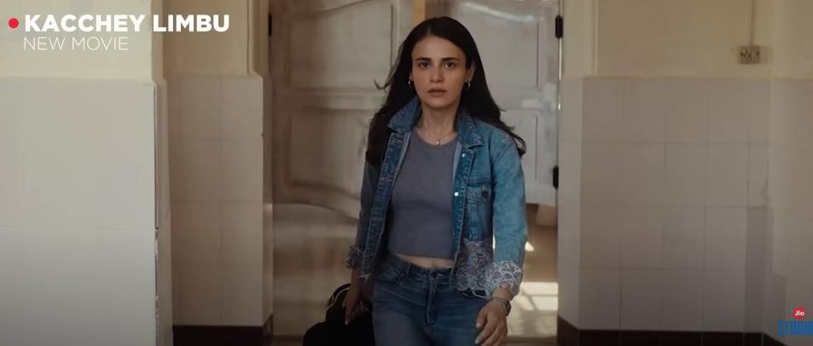
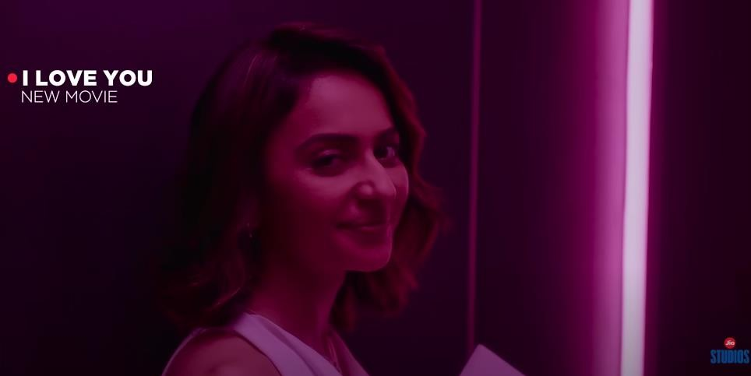
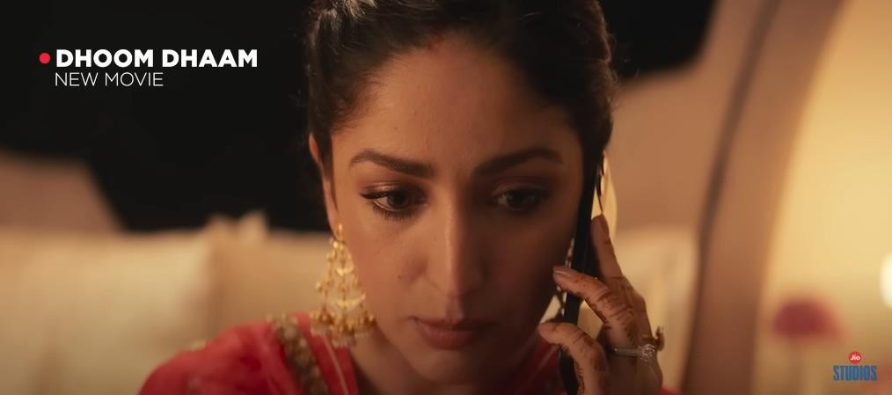
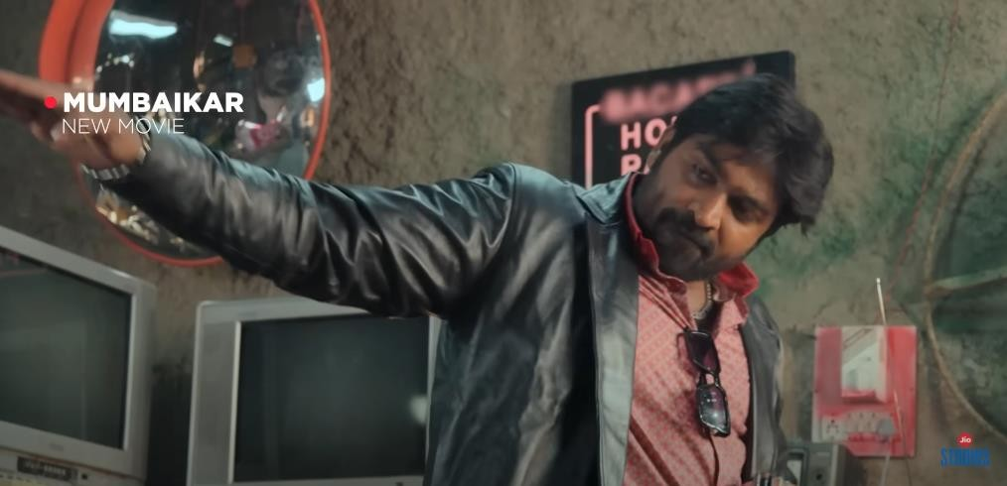
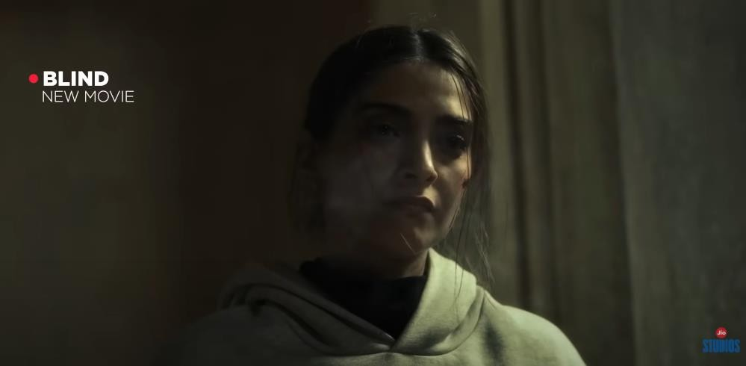
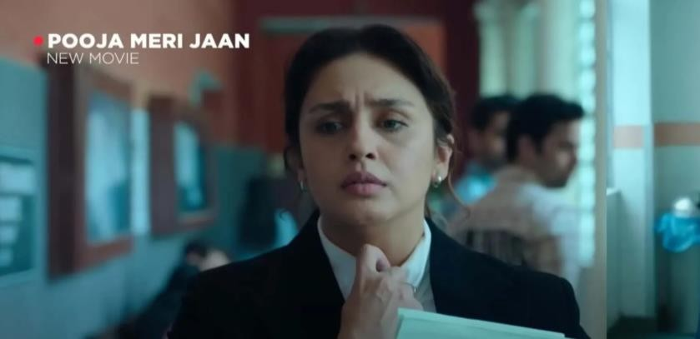
Launch: MAY
Launch: JUNE
MORE MOVIE PREMIERS
FEATURING POPULAR STARS
Launch: JUNE
Launch: JUNE
Launch: JULY
Launch: JULY

Slide 5
CLUTTER-BREAKING & GENRE-DEFINING ORIGINALS
L
a u n c h
: J U L Y
L
a u n c h
: M A Y
Launch: JUNE
Launch: JUNE
Launch: MAY
Launch: JULY

Slide 6
JUNE & JULY : CONTENT LINE UP
BOLLYWOOD MOVIE MANIA
MOVIE | LAUNCH DATE | LANGUAGE | RELEASE | STAR CAST
Mumbaikar | 02-Jun | Hindi | DTD | Vikrant Massey, Vijay Sethupathi
Bloody Daddy | 09-Jun | Hindi | DTD | Shahid Kapoor, Rajeev Khandelwal, Sanjay Kapoor
I Love you, Jaan | 16-Jun | Hindi | DTD | Rakul Preet Singh, Pavail Gulati
Dhoom Dham | 23-Jun | Hindi | DTD | Yami Gautam, Pratik Gandhi
Sergeant | 30-Jun | Hindi | DTD | Randeep Hooda, Adil Husaain
Trial Period | 07-Jul | Hindi | DTD | Genelia D Souza, Manag Kaul
Blind | 14-Jul | Hindi | DTD | Sonam Kapoor, Purab Kohli
Ishq E Nadaan | 21-Jul | Hindi | DTD | Mohit Raina, Lara Dutta, Neena Gupta,
Zara Hatke | 28-Jul | Hindi | Theatrical | Vicky Kaushal

Slide 7
JUNE & JULY : CONTENT LINE UP
REGIONAL LANGUAGE MOVIES :
MOVIE | LAUNCH DATE | LANGUAGE | RELEASE | STAR CAST
Godavari | 03-Jun | Marathi | Theatrical | Jitendra Joshi, Vikram Gokhale,
Sajan Re Jhoot Mat Bolo | 03-Jun | Bhojpuri | DTD | Chintu (Pradeep Pandey), Harshika Poonacha
Bewafa Sanam | 04-Jun | Bhojpuri | DTD | Pawan Singh, Smrity Sinha
Ghulam Chor | 11-Jun | Gujarati | DTD | Malhaar Thakkar, Vandana Pathak
Ghe Double | 17-Jun | Marathi | DTD | Bhau Kadam, Bharat Ganeshpure, Kishor Kadam
Tu Tu Mein Mein | 17-Jun | Bhojpuri | DTD | Ritesh Pandey, Madhu Sharma
Chandlo | 02-Jul | Gujarati | DTD | Kajal Oza Vaidya, Manav Gohil, Shraddha Dangar
Prantik | 16-Jul | Bangla | Theatrical
Unaad | 29-Jul | Marathi | DTD

Slide 8
REGIONAL CONTENT THAT HAS EVERYONE TALKING
HINDI
KANNADA
MARATHI
BENGALI
TAMIL
BHOJPURI
MALAYALAM
OTHERS
Launch: MAY
Launch: JUNE
MAAI (BHOJPURI)
GODAVARI (MARATHI)
GHE DOUBLE (MARATHI)
SAJAN RE JHOOTH MAT BOLO (BHOJPURI)
Launch: MAY
BOO
(TAMIL / TEL / HINDI)
Launch: MAY
Launch: JUNE
Launch: JUNE
Launch: JULY
Launch: JULY
Launch: JULY
ME VASANTRAO (MARATHI)
TU TU MAIN MAIN (BHOJPURI)
4 BLIND MEN (MARATHI)
UNAAD
(MARATHI)
DES MEIN NIKLA HOGA CHAND (BHOJPURI)
PRANTIK (BANGLA)

Slide 9
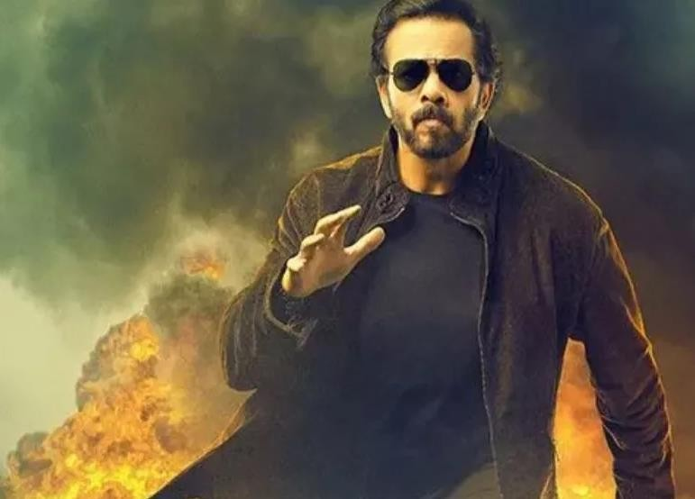
365 DAYS OF UNINTERRUPTED REALITY-BASED ENTERTAINMENT
Launch: 3rd JUNE
Launch: 15th JULY

Slide 10
DIGITAL REALITY
SHOW IS NOW ON
LAUNCHING : 17th June

Slide 11
23BN
1.1BN
VIEWS
32MN
VIEWERS
WATCH TIME
(MINS)
SEASON 2 GET READY TO BREAK ANOTHER SET OF RECORDS
WITH NONE OTHER THAN
SALMAN KHAN

Slide 12
Go Big On
The content of this presentation is proprietary work of Viacom18 and strictly confidential and privileged. Any use, any form of reproduction, dissemination,
copying, disclosure, modification, distribution and/or publication of any portion hereof is strictly prohibited and may be unlawful.
© Viacom 18 Media Pvt. Ltd., 2023

