Slide 1

Digital AD Units – IPL 2023

Slide 2

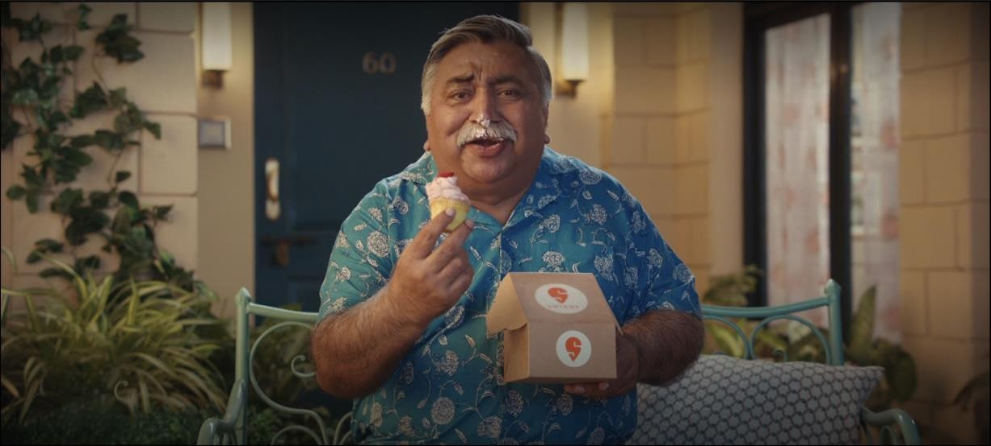
7B. AD Unit - Video inventory - Mid rolls –
CTV
Video
Ad Formats | Non-Skippable Video Ad
Deal Type | ASR
Supported Platforms | CTV
3rd Party Tracking | Yes
Clickability | No
Targetability | No

Slide 3
7B. AD Unit – Video inventory - Mid rolls – Spot - CTV
Composition
Brand video, Tracking Pixels
Event Tracking
Impressions (max 1 tracker supported)
Tracking Partners supported
Sizmek ( Preferred Partner ) DCM, Appsflyer, Branch, Singular,
Technical Specs
File Type: MP4
Supported Platforms: CTV
Aspect Ratio: 16:9
Frame rate: 25fps
Video File Size: Upto 100 MB

Slide 4
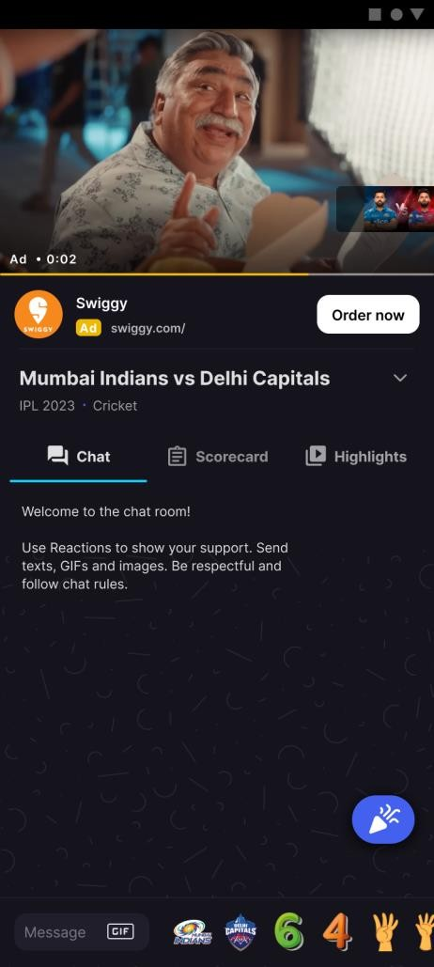
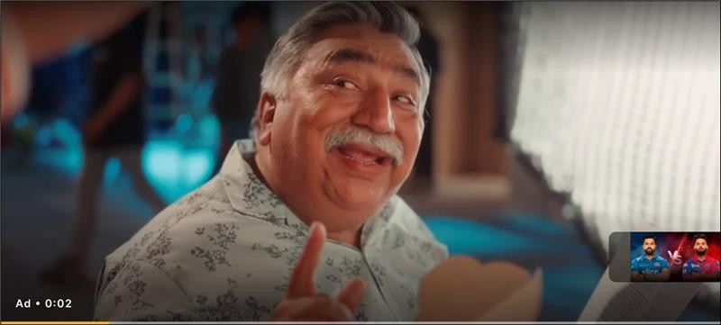

8. AD Unit – Video Ads with Companion – HH + Web (Pre/Mid Roll) , CTV – (Pre-Roll)
Video
Single Unit Ad – ( Video and Companion Element Together)
Ad Formats | Banner and Native
Deal Type | CPM
Supported Platforms | Android, iOS, M-Web, CTV (Pre-Roll), D-Web
Tracking | Not tracked separately (Imp/click tracking with the video ad)
Clickability | Yes / QR scan on CTV
Targetability | Yes (Same as the video ad to which it is attached)
In case Companion element isn’t present, the companion real-estate will be empty

Slide 5
8. AD Unit – Video Ads with Companion – HH + Web (Pre/Mid Roll) , CTV – (Pre-Roll)
Composition
Creative image , Ad Title, Ad Description, Advertiser Logo, CTA ( For companion )
Technical Specs
Companion
Creative Image Size: 320*50
Image File Size: Upto 150KB
Ad Text: For Ad Title - Upto 25 characters.
For Ad Description - No limit, first 25 characters display
CTA – Upto 10 characters (No special characters anywhere)
Logo – 50 x 50 px (within 10 kb)

