Slide 1

Digital AD Units – IPL 2023

Slide 2

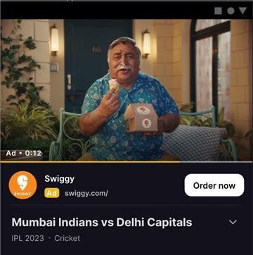
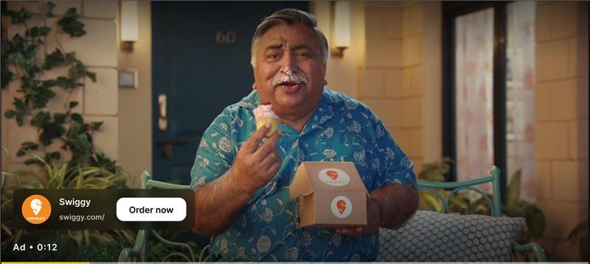
7A. AD Unit - Video inventory - Mid rolls –
HH + Web
Video
Ad Formats | Non-Skippable Video Ad
Deal Type | CPM
Supported Platforms | Android, iOS, M-Web, D- Web
3rd Party Tracking | Yes
Clickability | Yes
Targetability | Yes
18

Slide 3
7A. AD Unit – Video inventory - Mid rolls – HH + Web
Composition
Brand video, Landing Page URL, Tracking Pixels
Creative image , Ad Title, Ad Description, Advertiser Logo, CTA ( For companion )
Event Tracking
Impressions & Clicks (max 1 tracker for each supported)
Tracking Partners supported
Sizmek ( Preferred Partner ) DCM, Appsflyer, Branch, Singular,
Technical Specs
File Type: MP4
Supported Platforms: Android, iOS, MWeb, DWeb
Aspect Ratio: 16:9
Frame rate: 25fps
Video File Size: Upto 100 MB
Companion
Creative Image Size: 320*50
Image File Size: Upto 150KB
Ad Text: For Ad Title - Upto 25 characters.
For Ad Description - No limit, first 25 characters display (No special characters anywhere)
CTA – Upto 10 characters
Logo – 50 x 50 px (within 10 kb)
19

