Slide 1
Proof of Execution

Slide 2
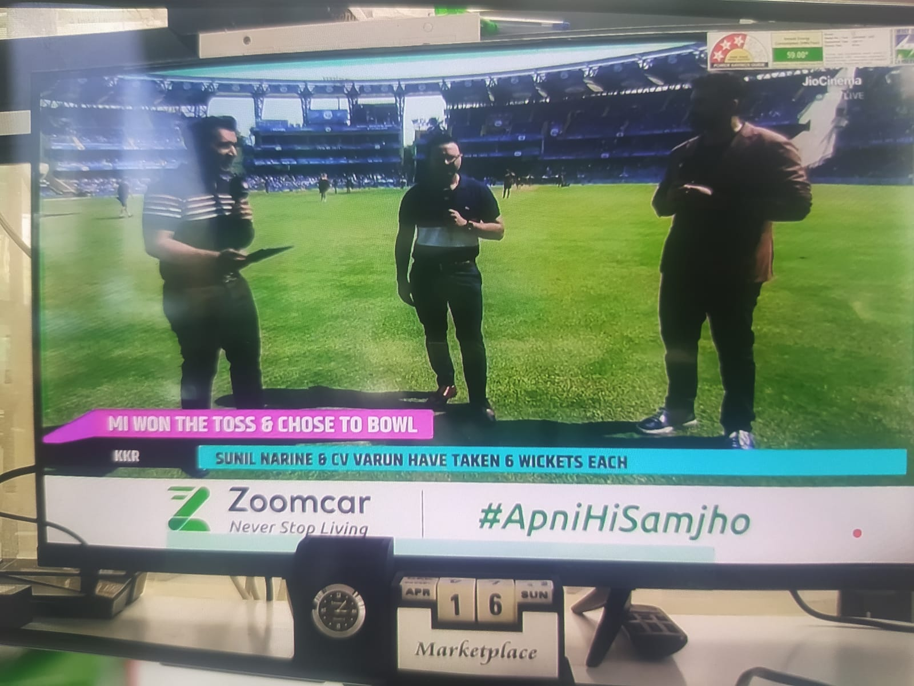
Screenshot

Slide 3
Recordings

Slide 4
Thank You

