Slide 1
CAMPAIGN EXECUTION GUIDELINES

Slide 2
CAMPAIGN EXECUTION GUIDELINES
After the creatives ( scripts/briefs/images) are provided, it will go for jingle production, once the creative/jingle is approved by the client, it’ll take up to 24-48 hours to make the campaign go live on the platform.
If any changes need to be made to the creative, it will take up to 5 working hours to make the new changes, once approved by the client it takes 24 hours to integrate the new changes into the ongoing campaign.
No campaign booking can be done on weekends.
If campaign has to go live on weekend it is recommended to do the booking before 4pm on Friday along with the approved creative, if the creatives comes after 5pm on Friday it will be taken up on Monday.
Brands will be provided with the Log Reports ( tentative time slot of when the ad will run) prior the campaign goes live and once the campaign ends the Broadcast Certificate Report (the exact time slots) will be shared with the client.
Log reports are provided on weekend as well however in few cases if log reports are not provided broadcaster certificate reports are provided at the end of the campaign.
Disclaimer(to be provided by the client) is mandatory for online betting and trading platform ads.
http://www.themediaant.com/

Slide 3
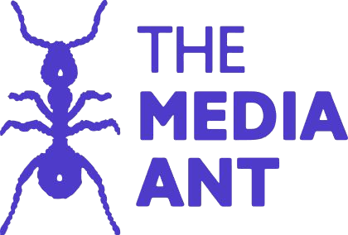
Thank You

