Slide 1
CAMPAIGN EXECUTION GUIDELINES

Slide 2
CAMPAIGN EXECUTION GUIDELINES
After the creatives are provided, it takes our quality check team 2 - 3 hours to examine the creatives for the right dimensions, content, resolution, etc.
After the creatives are checked and approved, it’ll take 24-48 hours to make the campaign live on the platform.
If any changes are to be made to the creatives/landing page, it will take up to 2 - 4 working hours to integrate the new changes into the ongoing campaign.
Brands will be provided with screenshots/videos and analytics sheet, in which the campaign report will be updated within 24 hours after it goes live.
In the analytics sheet, campaign report will be updated every 2 days till the campaign is live. No updates will be available on the weekends. Friday’s reports or campaigns going live on weekends will be updated on Monday.
http://www.themediaant.com/

Slide 3
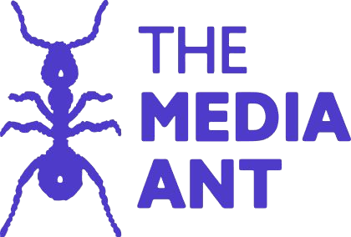
Thank You

