Slide 1
Plan

Slide 2
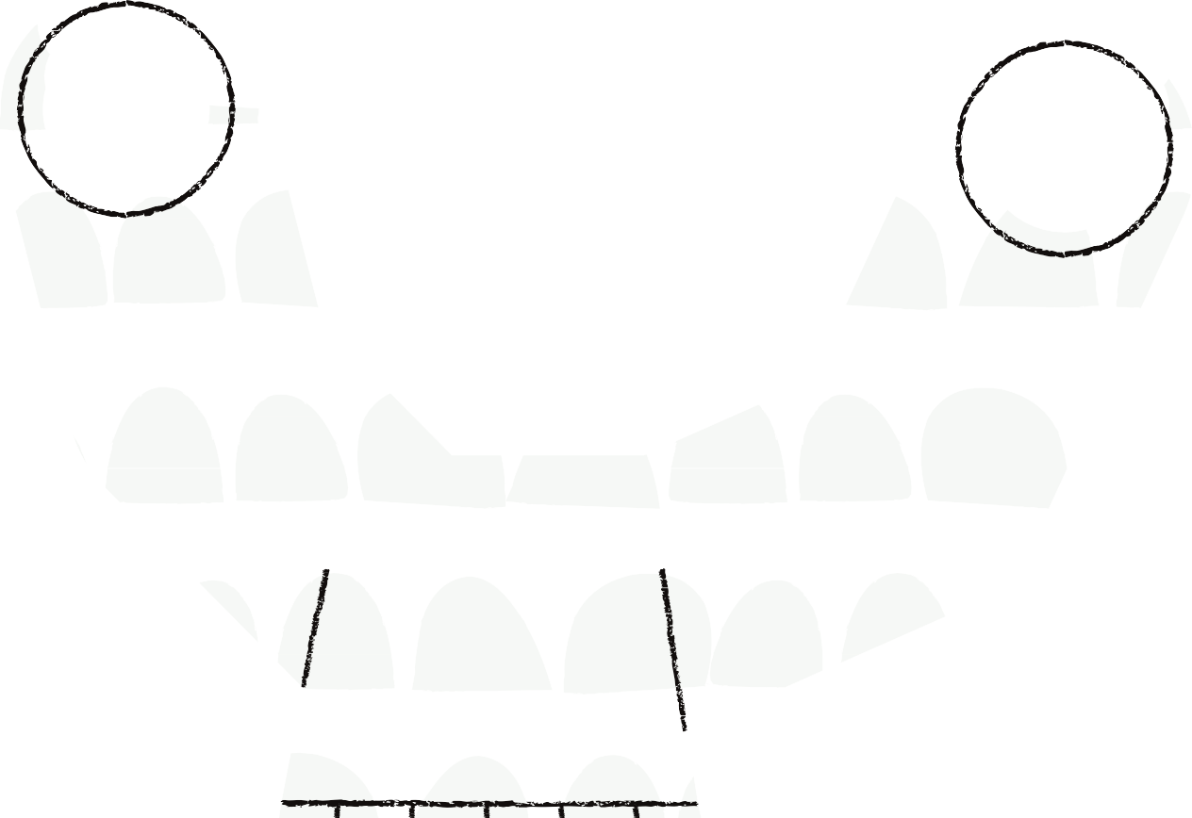
Sociiall Mediia Pages
61.1 MILLION+
MEME PAGES
40.3 MILLION+
MEME PAGES
1.6 MILLION+
TWELEBS
TAP HERE TO
CHECK THE PAGES

Slide 3
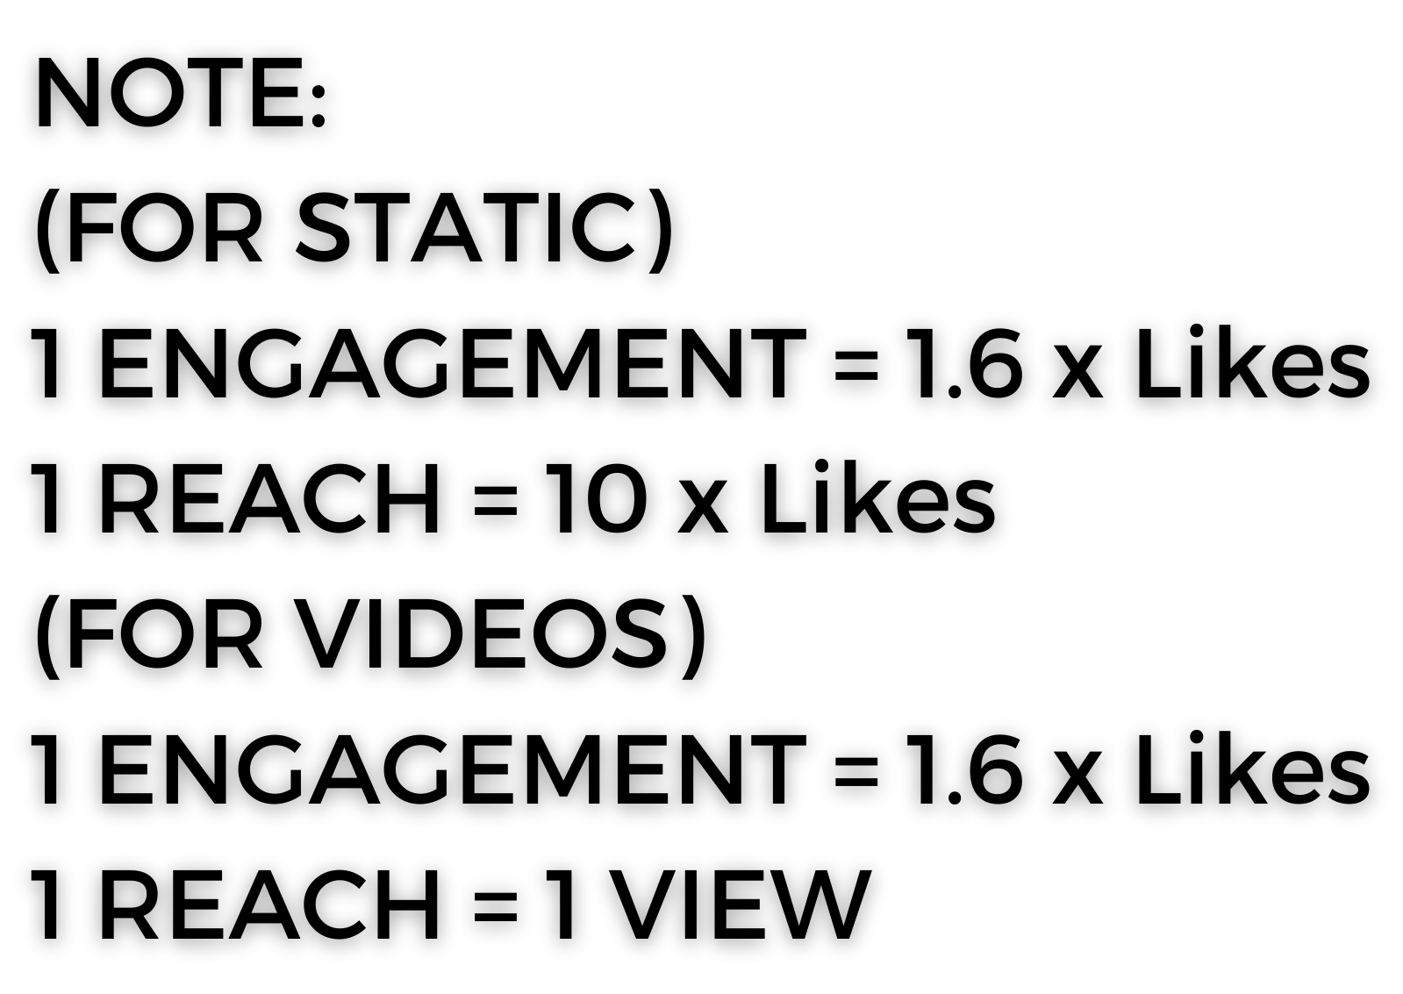
45 POSTS ON INSTA MEME PAGES
30 POSTS ON FACEBOOK MEME PAGES
23 TWEETS BY TWELEBS, 1 HOUR TWITTER TREND WITH OVER 1400 TWEETS
25 POSTS BY MEMEFLUENCERS
1000+ MEMES ON MEMECHAT APP
1 APP NOTIFICATION TO 300K MEMECHAT USERS
2M+ REACH
190K+ ENGAGEMENT

Slide 4
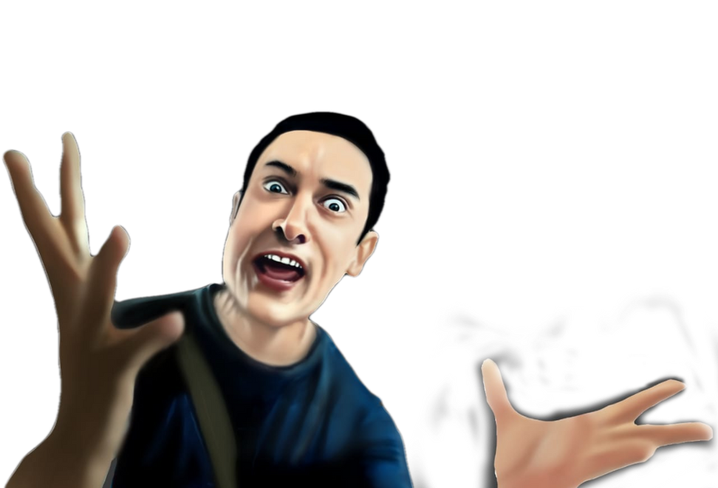
NOTE:
SINCE IT WILL BE OUR FIRST CAMPAIGN PARTNERSHIP , THE MEMECHAT APP WILL BE AN ADD-ON DELIVERABLE AT OUR END THIS ONE TIME, EXCLUSIVE OF THE BUDGETS WE CLOSE.
THIS WILL PROVIDE YOU WITH AN EXPERIENCE OF UNDERSTANDING THE POTENTIAL OF THE APP & POWER OF UGC MEMES
FREE! FREE! FREE!
This requires content from the brand’s end for us to amplify.

