Slide 1
Brand Lift Study: Campaign Evaluation Report
OCTAFX – June campaign

Slide 2
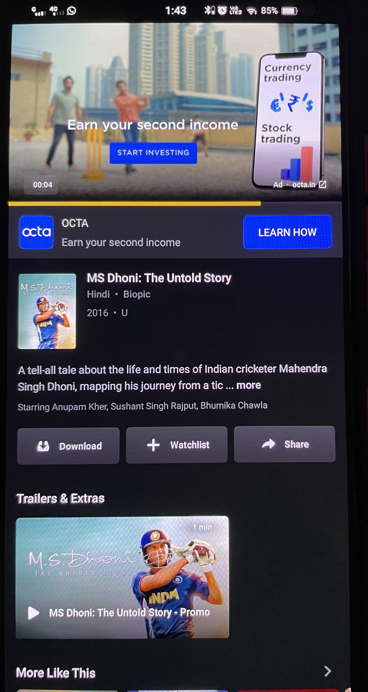
Campaign Performance
Key Results & Creative Evaluation

Slide 3
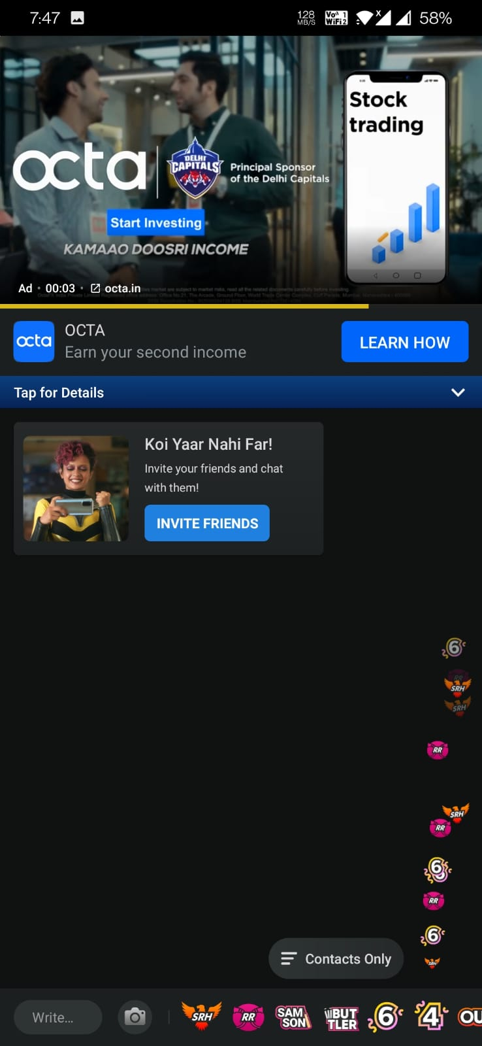
Impressions : 278 Mn
Campaign Metrics (Impact) - IPL
Clicks : 370 K
Reach : 92.5 Mn
Frequency - 3

Slide 4
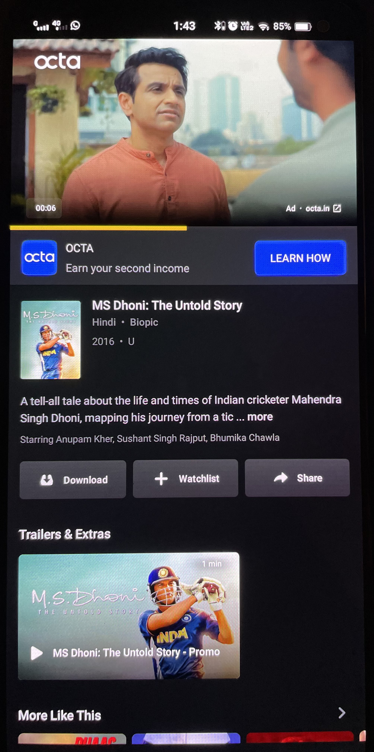
Impressions : 16 Mn
Campaign Metrics (Ent)
Completed Views : 15.5 Mn
Clicks : 14K
Reach : 5.7 Mn
The campaign ran with an average frequency of 3 and a completion rate of 97% garnering a reach of 5.7 Mn in 15 days

Slide 5
Creative best practices checklist
Brand prominently on all frames
Simple
Clear and Direct Messaging
Integrated the Brand Early
Ensured a clear role of the Brand in the story
Human/Celebrity presence
Source : Kantar
Kantar has setup some creative best practices for digital campaigns. These have been statistically tested.

Slide 6
SUMMARY
The campaign has delivered well to optimize reach and if continued would have yielded in substantial brand uplifts as an add on to the IPL campaign
01
According to Kantar’s creative best practices, OctaFX creatives checked 4of 5 points that are essential for running a successful campaign. It is recommended to run longer and shorter form creatives for better story telling and conversion
02

