Slide 1
Step Earn Redeem

Slide 2
Campaign Report

Slide 3
Notification and Pop-up

Slide 4
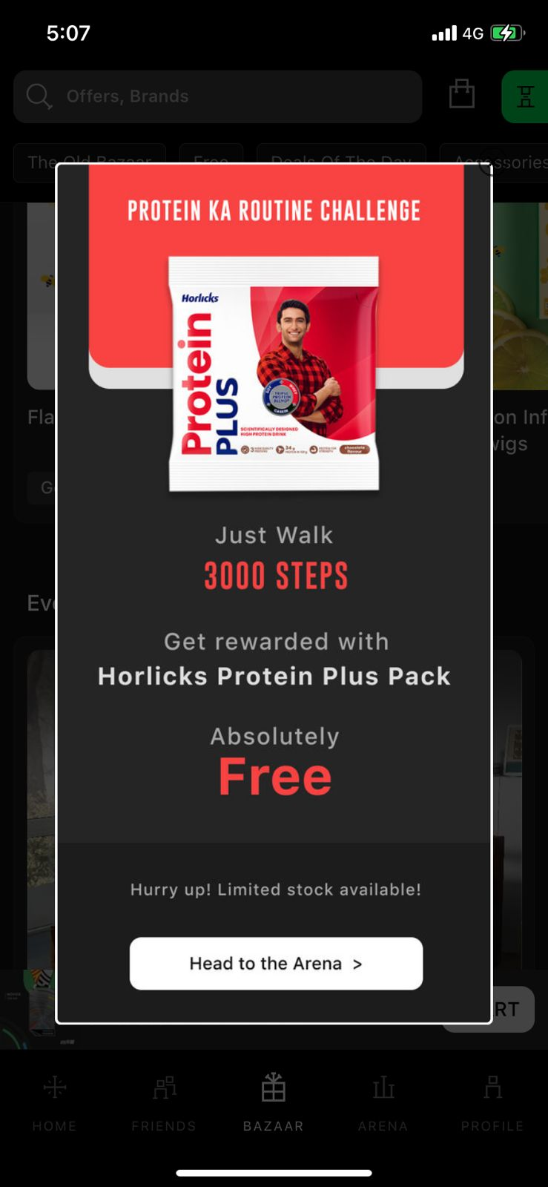
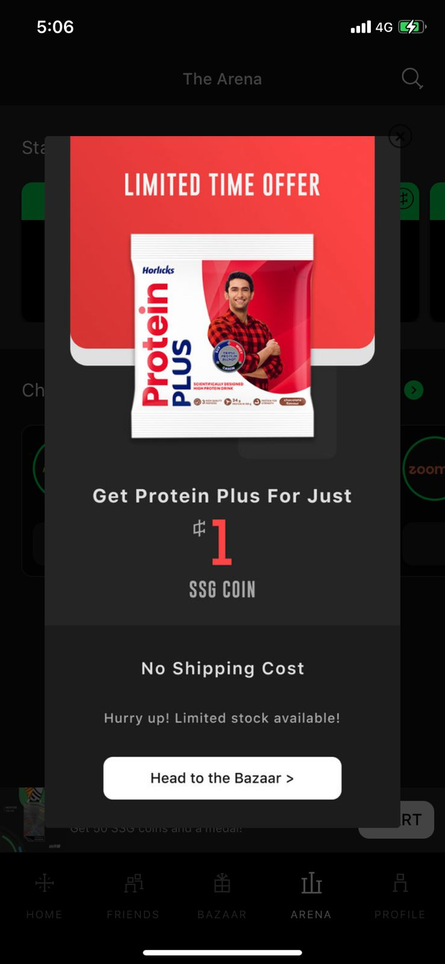
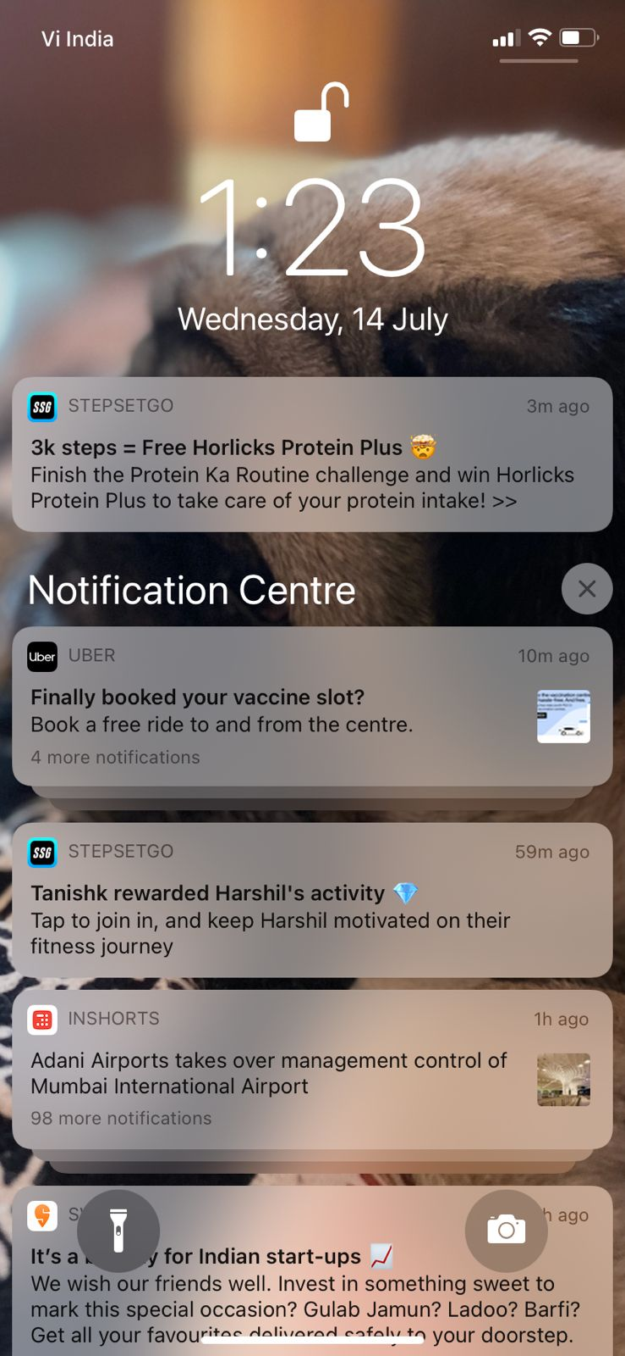
Push Notification
In-app Pop ups

Slide 5
Arena

Slide 6
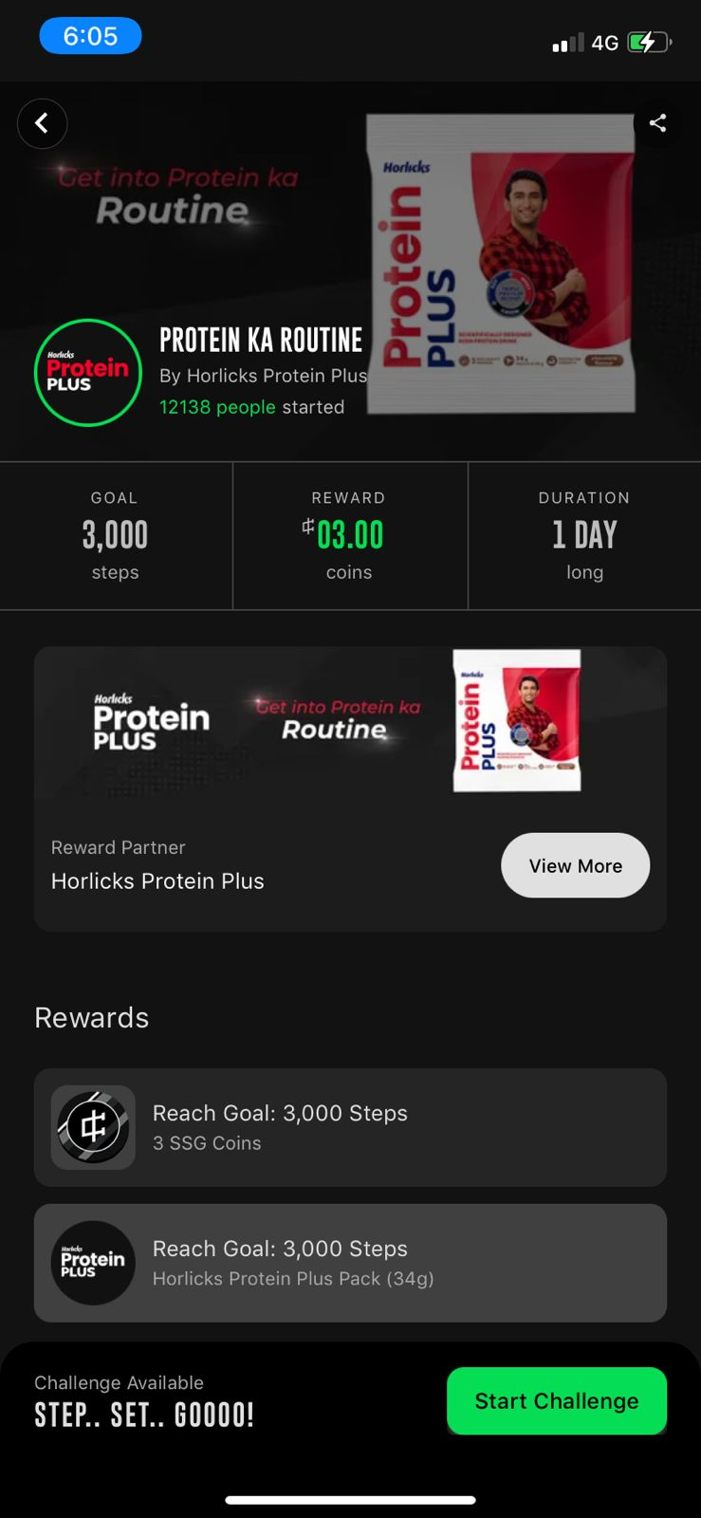
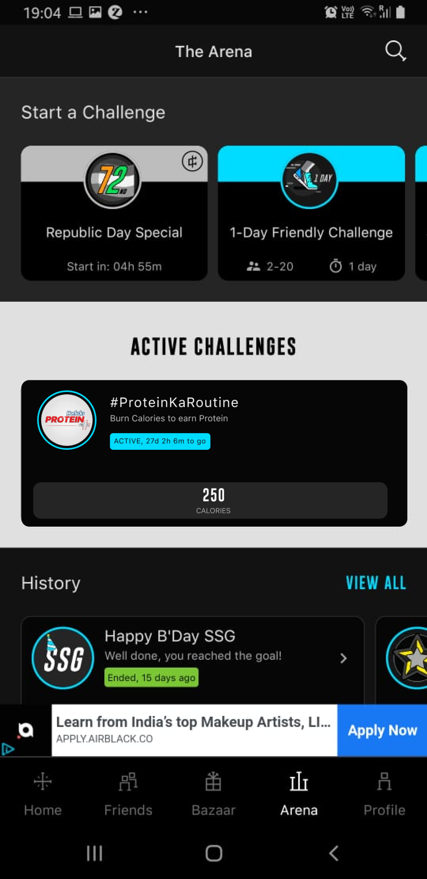

Slide 7
Bazaar Widget

Slide 8
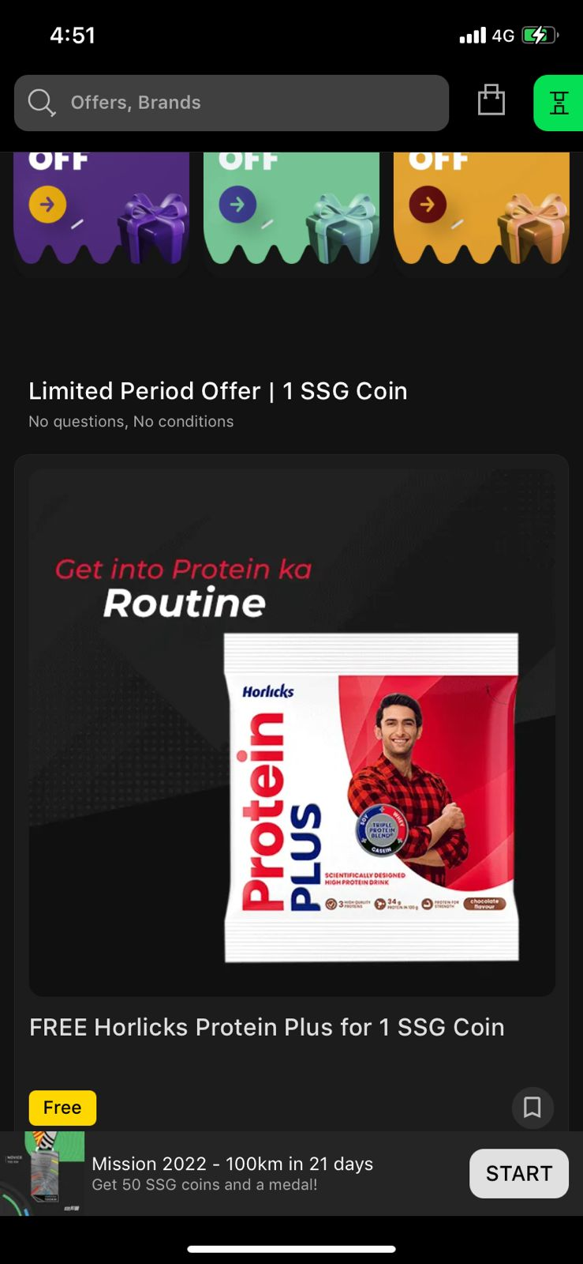
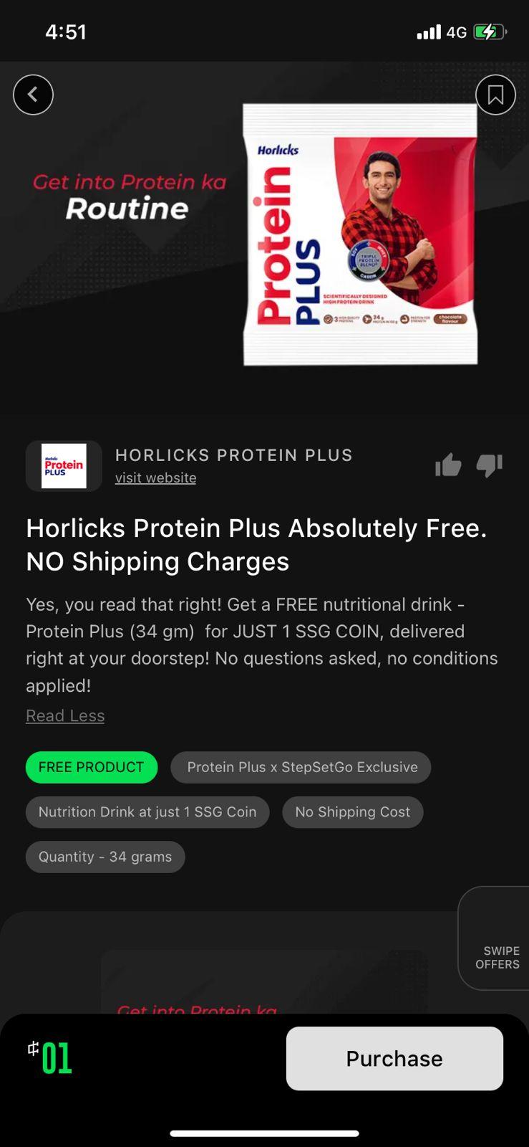
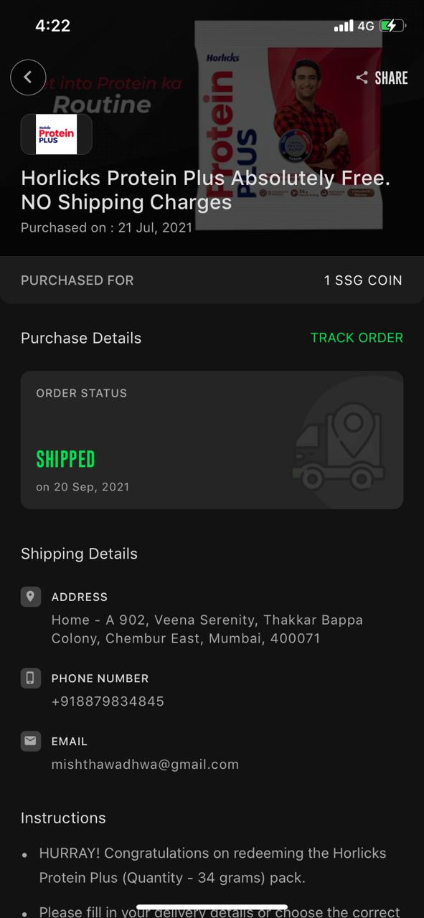

Slide 9
In-app branding

Slide 10
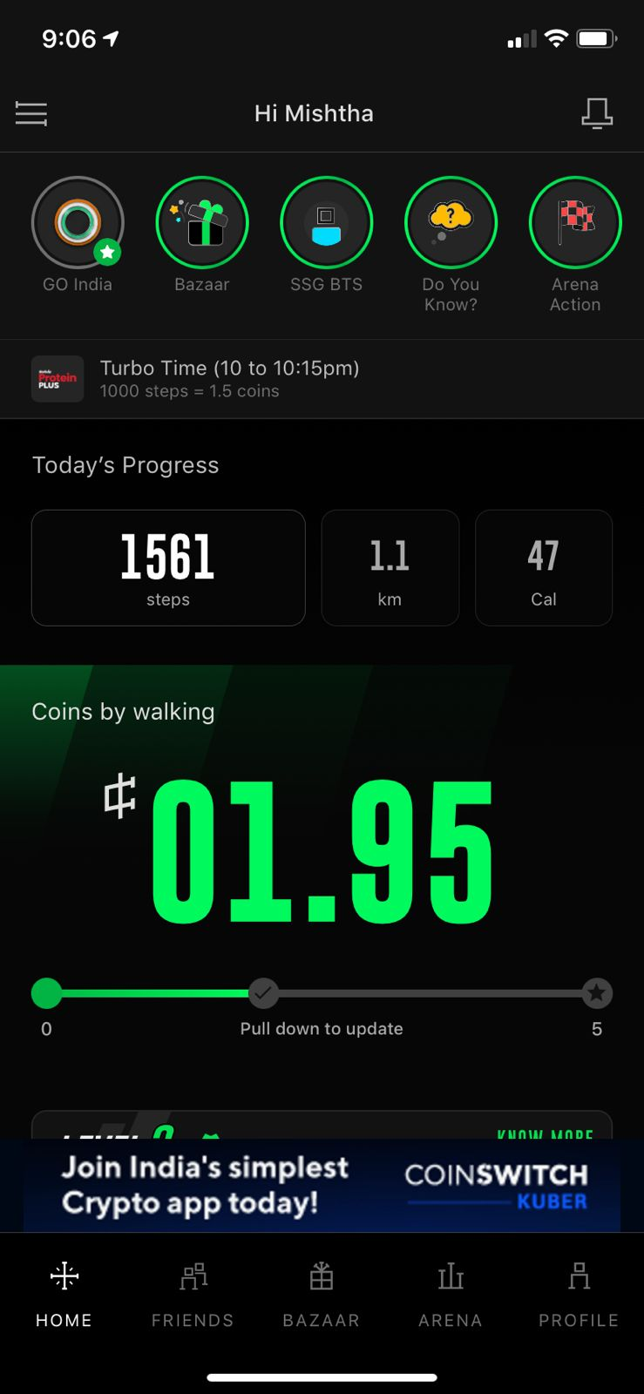
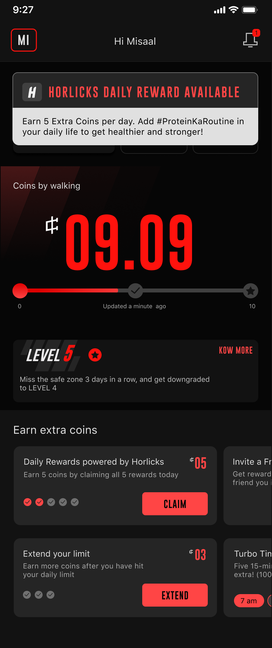
Turbo Time Branding
Daily Reward Branding

Slide 11
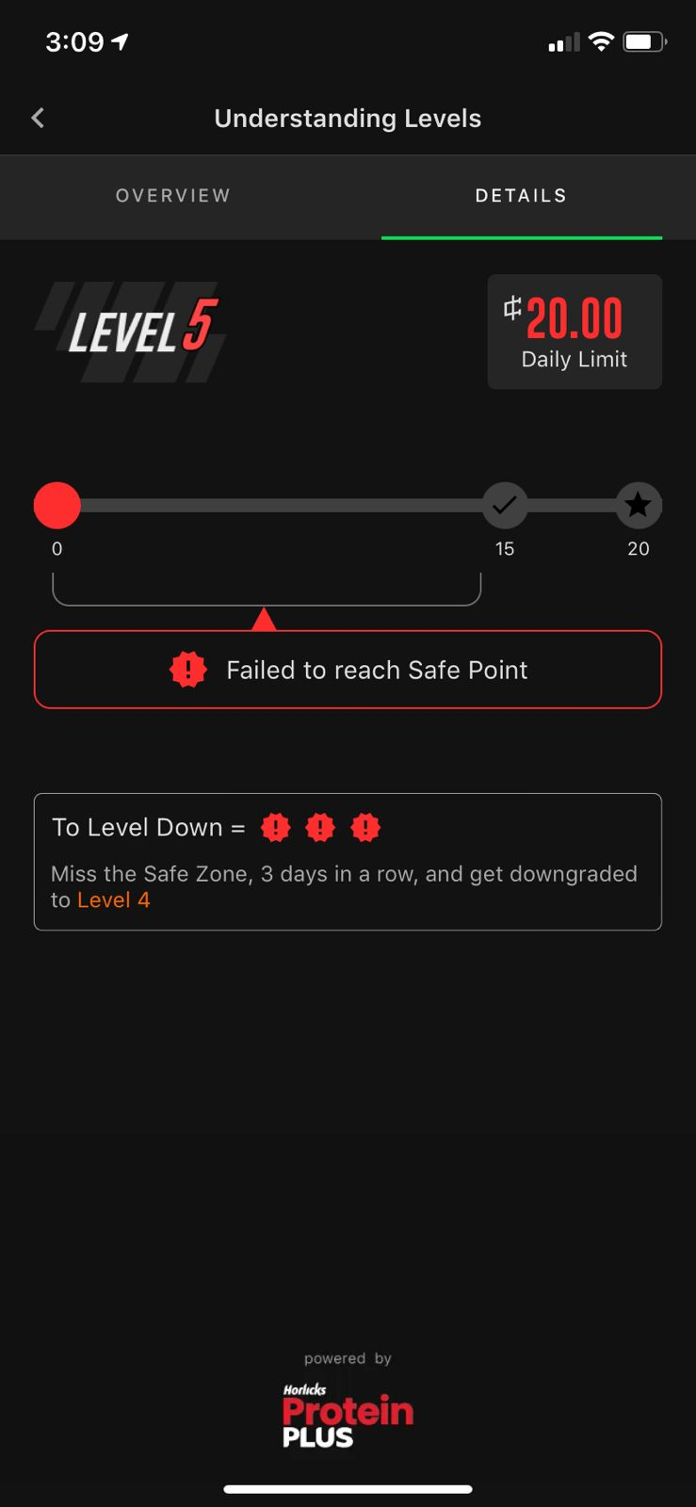
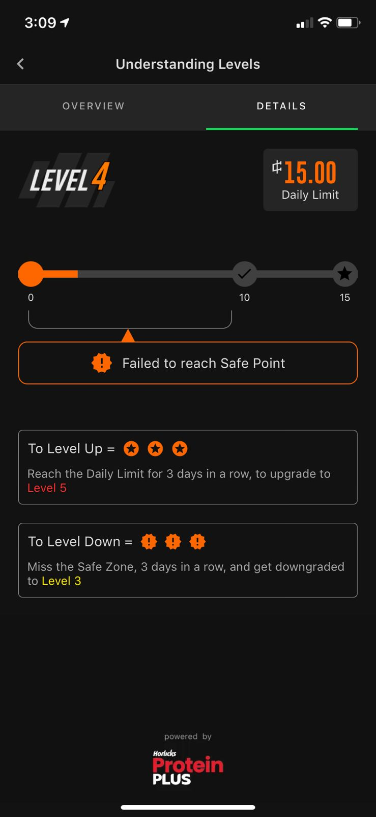
Level 5 branding
Level 4 branding

Slide 12
Daily Reward AD

Slide 13
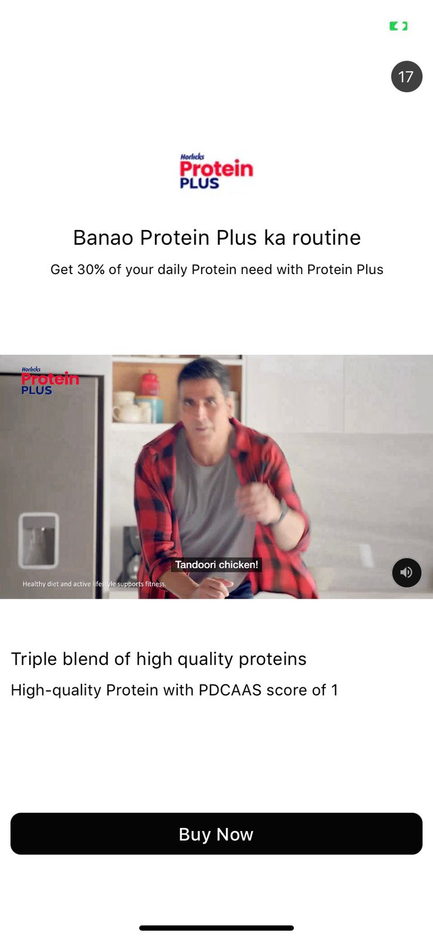

Slide 14
Sr. No. | Activity | User Count
1. | Challenge Participation | 61,107
2. | Bazaar widget Impressions | 9,11,644
3. | Bazaar Reach (Unique) | 70,435
4. | Bazaar CTR | 1648
5. | Ad Impressions | Report Link
6.r | Ad Completed Views
7. | Ad Video Clicks
8. | Samples Distributed | 60,000
9. | Turbo Time Impressions | 4,66,82,087
10. | Daily Rewards Card Impression | 1,23,89,278
11. | Level Impressions | 15,98,315

Slide 15
Thank You

