Slide 1
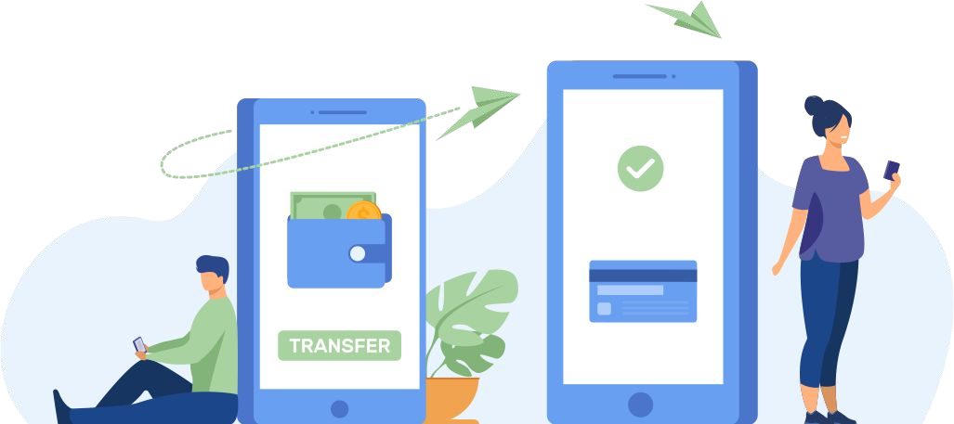
Reach Transacting Audiences now on

Slide 2
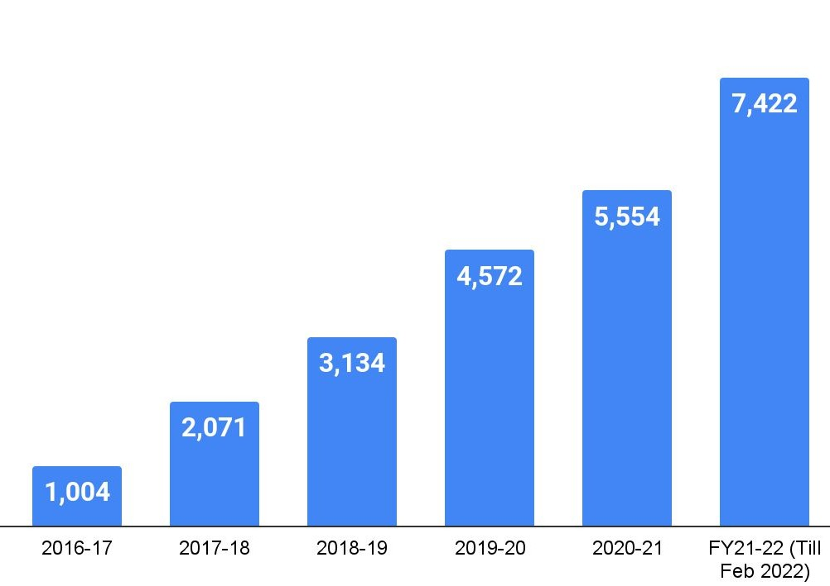
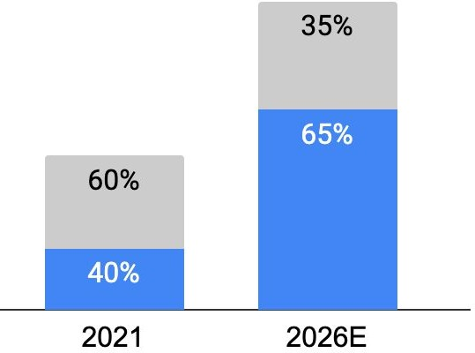
Burgeoning Digital Payment Transactions in New India
~740%
2 out of 3
Growth in digital transactions since 2016
Transactions to be digitized by 2026
Volume of digital payment transactions (in crores)
COVID-19
Total Payments (USD Tn)
Bharat QR
USD 15-16 TN
Demonetisation
BHIM/UPI
USD 7-8 TN
Source: Ministry of Electronics and Information Technology; BCG & PhonePe Pulse
Cash
Digital

Slide 3
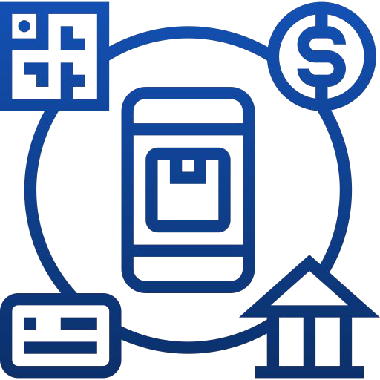
Online Payment Customer Journey: Signals captured by payment gateways
Merchant (Spend Category)
Transaction Mode
Checkout Initiated
Payment details under processing
Acquirer
Customer
Payment Gateway
Transaction successful
Details authenticated Funds transferred
Issuing Bank
Affluence & Digital Payment Savviness
Bank Type

Slide 4
Deterministic Data captured via 3B+ transactions from 360M+ users across 600K+ merchants
Verticals
Airlines Utilities/Bill Pay E-Commerce B2B
Education/E-Learning Financial Services OTTs
ERPs/Shopping Platforms

Slide 5
Disney+ Hotstar Audience Data Enrichment stack now
offers new signals- online payments
Content Preferences
Online Spend Categories
Demographics
Payment Method
REACH TRANSACTING AUDIENCES NOW ON INDIA’s BIGGEST OTT PLATFORM
Location
Bank Type
NCCS Classification
Digital Payment Savviness/ Affluence
Appographic data

Slide 6
Data enrichment in a privacy safe environment
Partner Data
Refreshed monthly
Matching Enrichment
Custom Cloud Data Clean Room
HS Ads Server
User served an ad
Hotstar Data
Data captured with user consent.
Data encrypted with SHA 256 encryption and rotating salt.
Data managed on secure cloud with server level logs and regular purge.

Slide 7
Get access to audience cohorts basis transaction data and persistent identifiers
Spend Category
Transaction Mode
Affluence
Digital Payment Savviness
Bank Type
Fashion
- Electronics
- Insurance
- Travel
Food etc.
- Debit card
- Credit Card
- Netbanking
- UPI
- Affluent
- Mass market
- Aspirer
- High
- Medium
- Low
- Private/MNC Bank
- PSU Bank

Slide 8
What is Affluence and Digital Payment Savviness?
Affluence is defined as per their average ticket size, normalised as per average category spends
Digital Payment Savviness index measures extent of users’ trust and adoption in online payments.
Affluence Segment | Average ticket size per transaction
Affluent | 1,500+
Mass Market | 600+
Aspirer | 200+
Savviness Segment | Normalised transaction Count
High | >2X
Medium | 1X
Low | <0.5X
Digital Payment Indicators:
Age on payment gateway
# of merchants transacted on
Single vs multiple device users
Frequency of transactions

Slide 9
100+ cohorts across
100 Mn+ users
Category | Sub Category | Size
Spend Category | B2B | 21M
Spend Category | Education | 16M
Spend Category | Electronics | 11M
Spend Category | Entertainment | 29M
Spend Category | Fashion And Jewellery | 21M
Spend Category | Food | 21M
Spend Category | Insurance And Investments | 12M
Spend Category | Online Supermarket | 24M
Spend Category | Telecom And Broadband | 41M
Spend Category | Travel And Hospitality | 29M
Spend Category | Utilities And Bill Pay Agg | 20M
Transaction Mode | Credit Card Holder | 22M
Transaction Mode | Debit Card Holder | 49M
Transaction Mode | Net Banking Transaction | 26M
Transaction Mode | UPI Transaction | 24M
Affluence | Affluent | 11M
Digital Payment Savviness | High | 30M
Bank Type | Private And Mnc Bank | 22M
Bank Type | PSU Bank | 24M
100 mn+ Hotstar Transacting viewers now available for your brand campaign!
Universe size; monthly estimates to be shared on request

Slide 10
AUTO
Recommended transacting cohort for automobile brands
Identifier | Cohort Name
Spend Category | Intra-city Travel
 | Travel & Hospitality
 | Insurance & Investment
Transaction Mode | Premium & International cards
Affluence | Affluent
 | Mass Market
Digital Payment Savviness | High
 | Medium
22+ MN
Uniques
Universe size; monthly estimates to be shared on request

Slide 11
BFSI
Recommended transacting cohort for Banking, Finance and Insurance Products
Identifier | Cohort Name
Spend Category | Credit Repayment Digital Wallets Insurance & Investment Personal Loan Travel & Hospitality
Transaction Mode | Net Banking, UPI, Debit Card, Credit Card
Affluence | Affluent, Mass Market, Aspirer
Digital Payment Savviness | High, Medium, Low
Bank Type | MNC/PSU/Private
Custom | Risk Score Bureau hit likelihood score Unsecured loan propensity score Trust score
35+ MN
Uniques
Universe size; monthly estimates to be shared on request

Slide 12
GAMING
& FANTASY
Recommended transacting cohort for Fantasy, Rummy and Poker brands
Identifier | Cohort Name
Spend Category | Gaming
 | SMB Owners
Transaction Mode | Premium & International cards
Affluence | Affluent
 | Mass Market
 | Aspirer
Digital Payment Savviness | High
 | Medium
Custom | High and Medium Propensity for gaming and gambling
26+ MN
Uniques
Universe size; monthly estimates to be shared on request

Slide 13
Recommended transacting cohort for Media, Entertainment and Online Portals (Matrimony, Jobs, Real Estate)
M&E
Identifier | Cohort Name
Spend Category | Entertainment
 | Job Portal Subscribers
 | Matrimonials
 | SMB Owners
 | Real Estate Marketplaces
 | Education (School, Universities, Tuition, Upskilling)
Transaction Mode | Premium & International cards
Affluence | Affluent
 | Mass Market
Digital Payment Savviness niverse size; monthly estimates to be shared on | High
 | Medium request
21+ MN
Uniques
U

Slide 14
Online
Recommended transacting cohort for Online Brands
Identifier | Cohort Name
Spend Category | Online Supermarket Food Deals and Coupons Gifting Travel & Hospitality Healthcare & Fitness Intra-city Travel SMB Owners
Transaction Mode | Net Banking, UPI, Debit Card, Credit Card Premium & International
Affluence | Affluent, Mass Market, Aspirer
Digital Payment Savviness | High, Medium, Low
35+ MN
Uniques

Slide 15
Consumer Durables & IT
Recommended transacting cohort for Consumer Durables and IT
Identifier | Cohort Name
Spend Category | Electronics
 | Deals and Coupons
 | E-Commerce
 | Home Improvement
 | Utility and Bill Payments
Affluence | Affluent
 | Mass Market
 | Aspirers
Digital Payment Savviness niverse size; monthly estimates to be shared on request | High
 | Medium
23+ MN
Uniques
U

Slide 16
Food & Beverages
Recommended transacting cohort for Food and Beverages
Identifier | Cohort Name
Spend Category | Food Online Supermarket Grocery Healthcare and Fitness Deals and Coupons Travel and Hospitality, Forex
Affluence | Affluent
 | Mass Market
 | Aspirers
Digital Payment Savviness | High
 | Medium
Transaction Mode | Premium & International cards (for alco-bev)
24+ MN
Uniques
Universe size; monthly estimates to be shared on request

Slide 17
Personal Care
Recommended transacting cohort for Personal Care brands
Identifier | Cohort Name
Spend Category | Online Supermarket
 | Healthcare and Fitness
 | Fashion and Jewellery
 | Gifting
 | Deals and Coupons
Affluence | Affluent
 | Mass Market
 | Aspirers
Digital Payment Savviness Universe size; monthly estimates to be shared on request | High
 | Medium
20+ MN
Uniques

