Slide 1
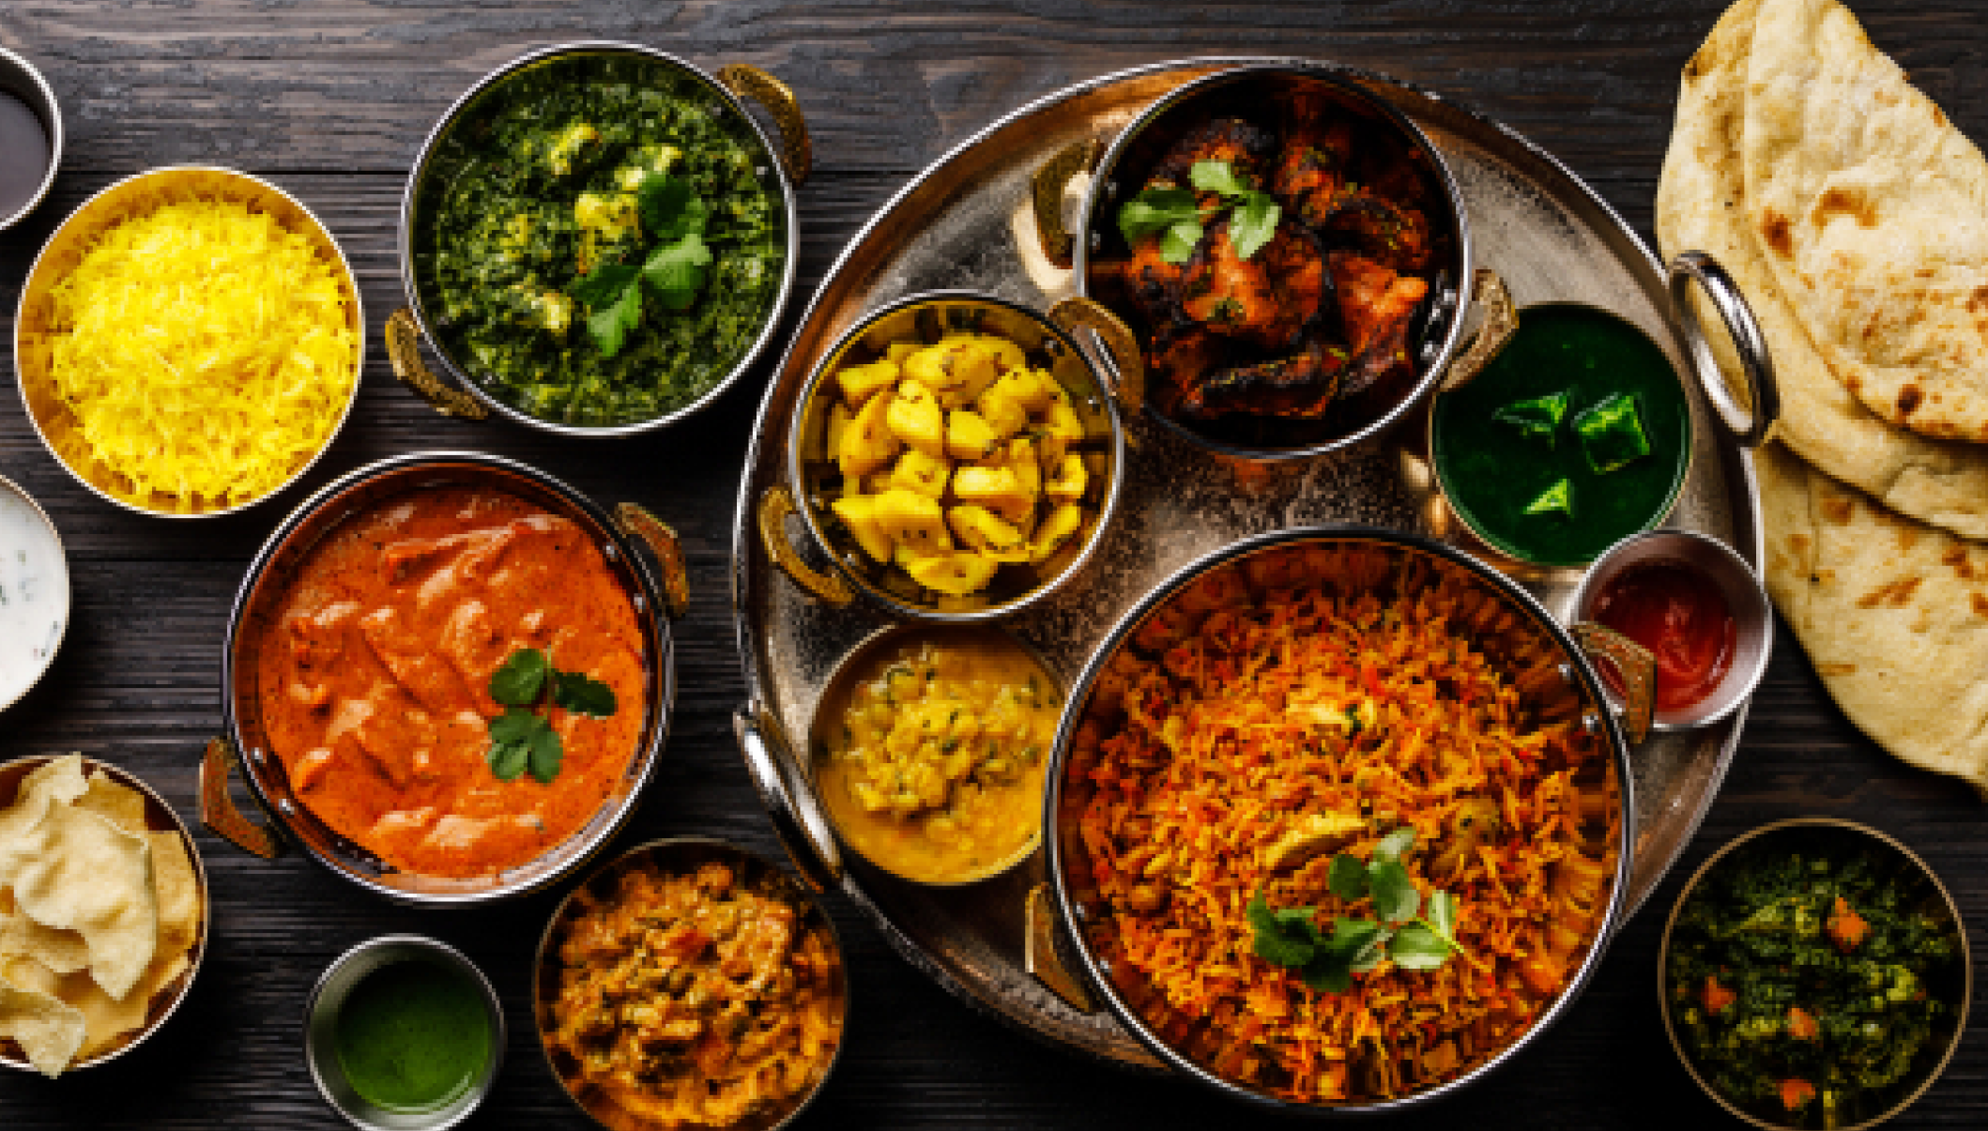
ShareChat

Slide 2
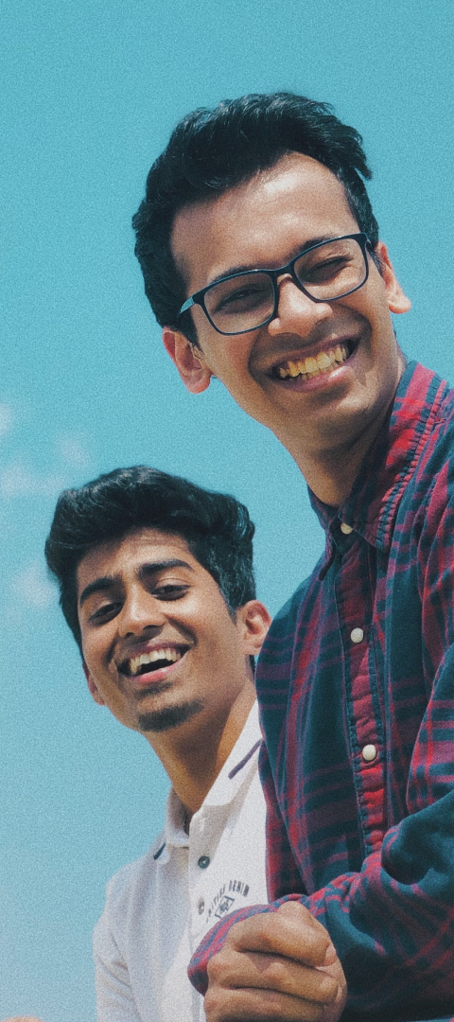
Bharat ka #1
Social Media App
1 in 4 Internet users in India is using ShareChat

Slide 3
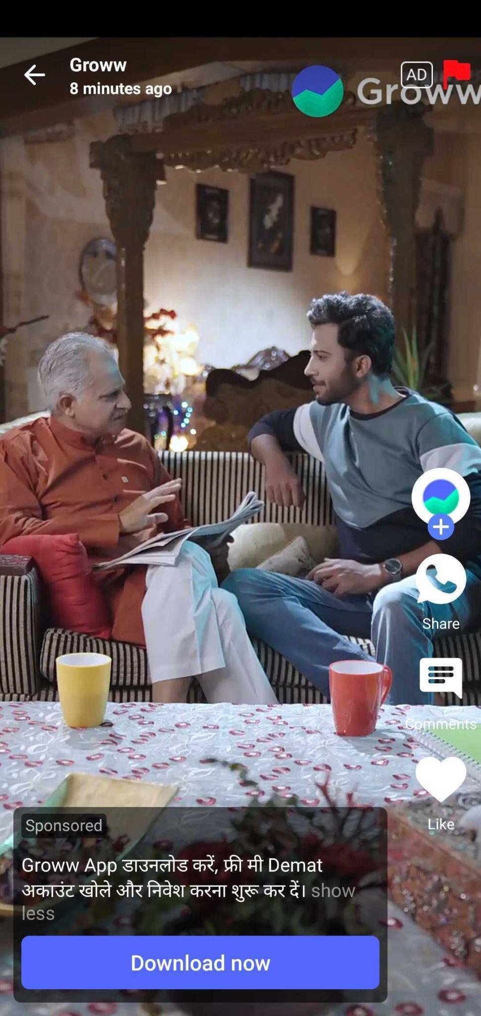
GROWW
Objective To Promote Groww App to get awareness on Demat A/C, SIP & Mutual funds in the Hindi Speaking Market.
Target Market
Hindi Audience, PAN India
Target Audience
Male & Female
Age Group
25 to 44
Campaign Duration 01st Nov To 14th Nov
Target
7 Mn Video Views .

Slide 4
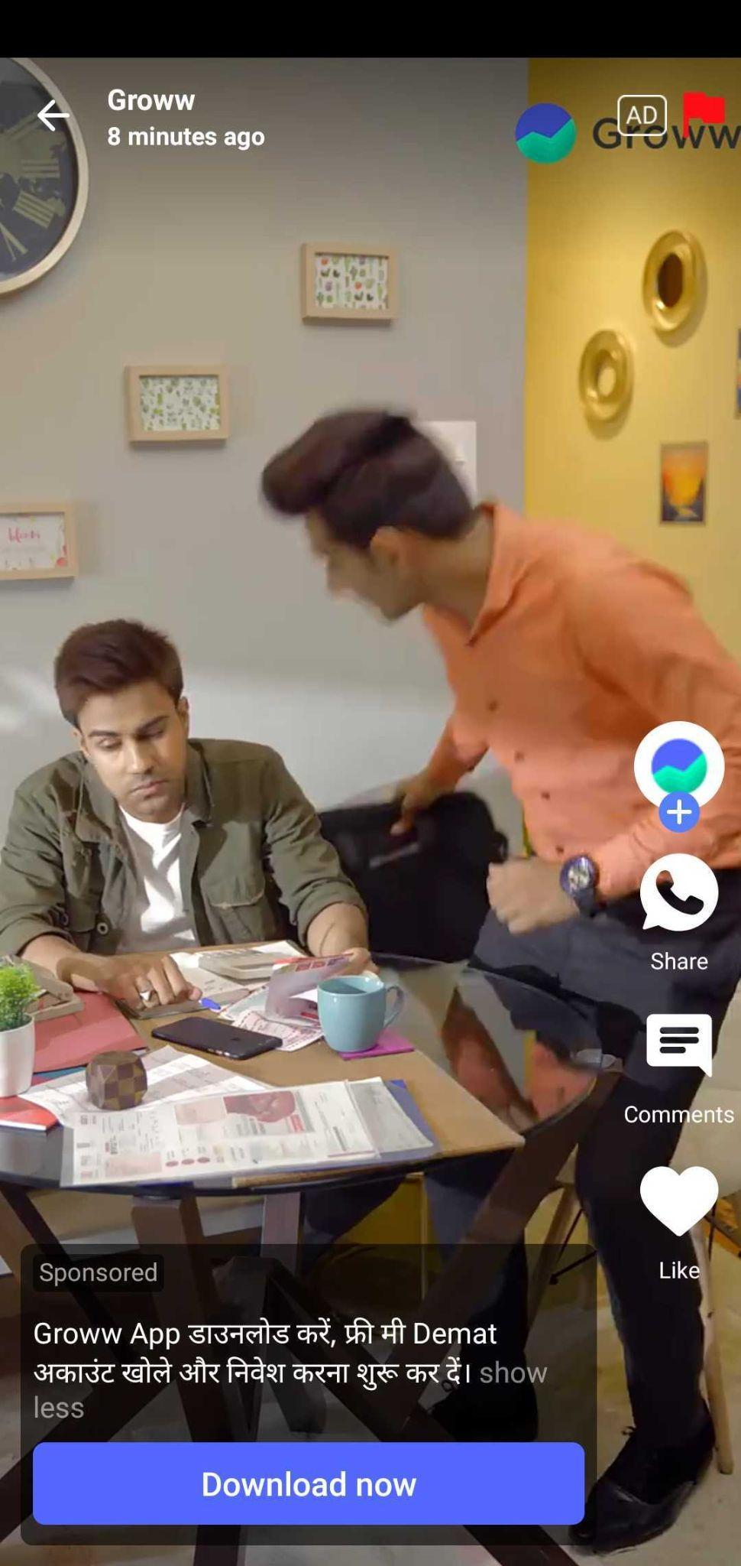
Evaluation Report
Total Achieved Impressions
Total Achieved Views
11.2 Mn+ Impressions
7.1 Mn+ Views
Total Achieved Clicks
Achieved VTR%
28.3 K+ Clicks
63.19% VTR

Slide 5
Creative-Wise Report
Banner Name | Impressions | Clicks | CTR | Views | VTR
Groww_HIN_Creator_ad-Grow-Concept-1 | 3936780 | 9065 | 0.23% | 2425108 | 62%
Groww_HIN_Creator_ad-Grow-Concept-2 | 4016602 | 9681 | 0.24% | 2590213 | 64%
Groww_HIN_Creator_ad-Grow-Concept-3 | 3344732 | 9571 | 0.29% | 2123707 | 63%
Total | 11298114 | 28317 | 25% | 7139028 | 63%

Slide 6
Top 10 Regions
Uttar pradesh
Maharashtra
Madhya pradesh
Rajasthan
Bihar
Chhattisgarh
Haryana
Delhi
Jharkhand
Uttarakhand

Slide 7
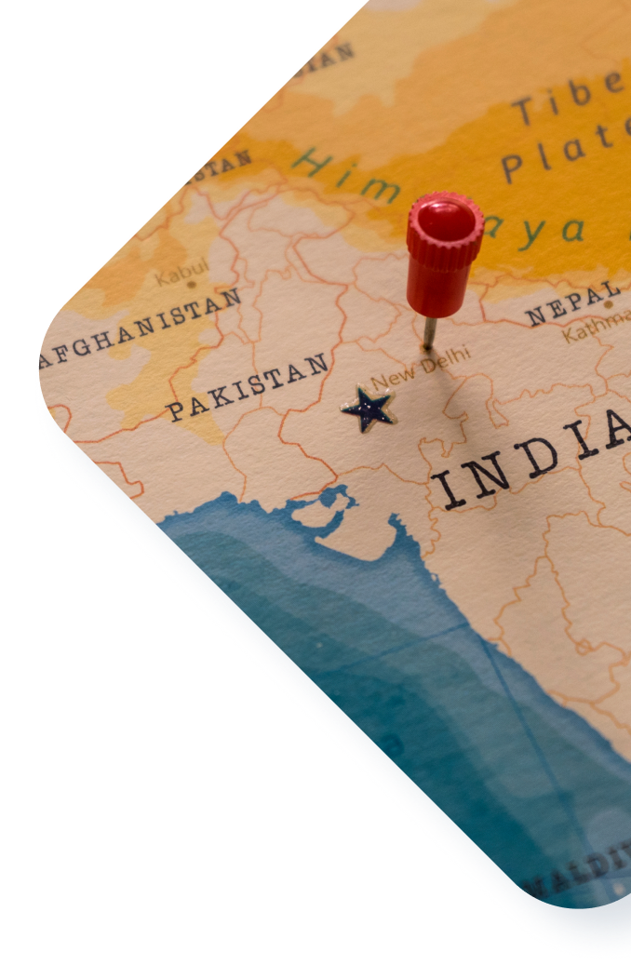
Our pup says
Thank you for your time

