Slide 1
Case Studies

Slide 2
Crypto Lending & Investment platforms are building their breakout-
growth through large scale acquisitions on PhonePe
Brand Objectives
Impact Delivered
★ First Time User Transactions (Trade/Investment)
★ Loan Disbursals to ETCs and good Credit score holders
★ Account Opens/KYC Verification for Banks
CPA: 400-600
CPA 400
Target Audience - 80 Mn
★ Wealth Management Community at PhonePe ~35 Mn
★ Loan Seekers ~30 Mn
★ HNI & Ultra HNI Users ~15 Mn
CPA: 1200
CPL: 500

Slide 3
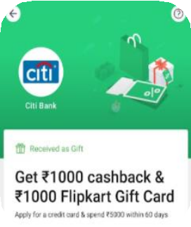
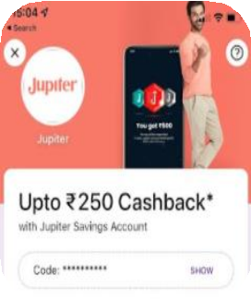
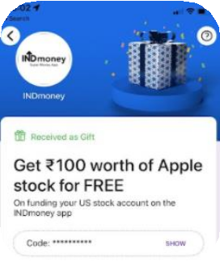
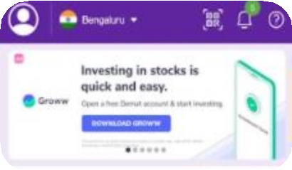
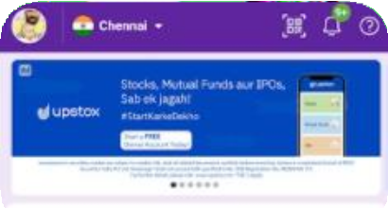
BFSI
Rewards Case Studies
Display Case Studies
Objectives
Impact
Objectives
Impact
★ First time transactions
★
★ CPA - 500-600
★
★ Build awareness and drive
★ 200-300 Mn+ impressions
Acquire ETC users
CPFT - 1000
traffic
per brand monthly
★ CTR - 0.7%-1.5%

Slide 4
PhonePe drives digital journeys for some of the largest brands in FMCG sector
Brand Objectives
Impact Delivered
★ New user acquisition
★ Achieving high ROAS
★ Deep penetration in tier-2,3 and beyond
★ Upcoming discussions: Driving Brand Objectives
ROAS - 3X
Conversion 0.3%-0.6%
ROAS - 4X
Conversion 0.6%- 1%
Target Audience - 115 Mn
★ E-commerce spenders
★ Users showing affinity towards daily needs
★ Users with budget to mid-income handsets lower
value products
★ High spend index users for premium brands
ROAS - 5X
Conversion 0.4%-0.8%
ACOS ~40%
16

Slide 5
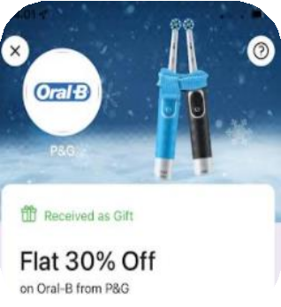
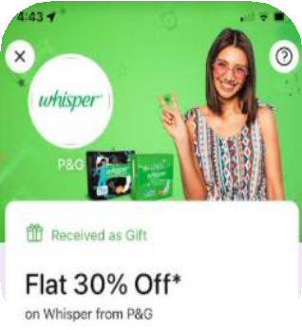
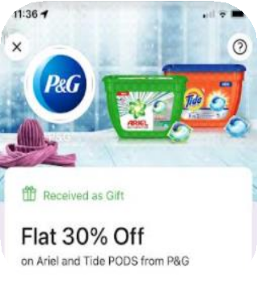
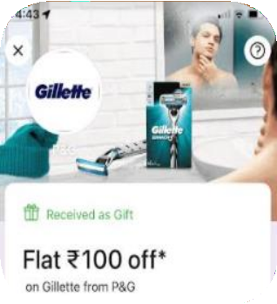
P&G reached 105 Mn users to drive acquisition across 8+ brands through customized cohorts for their D2C growth
Objectives for P&G
Campaign Impact
★ New User acquisition
★ Business growth across eCommerce platforms
★ Build Awareness & Recall of P&G D2C
★ Reach - 105Mn
★ ROAS achieved - 4X
★ CACs driven - 50-300
Key Customer Insights
★ Primary transactors from Tier-2 & 3 cities
★ Online lifestyle users with spends across ecommerce, OTT & household categories form the highest responders set
★ Health & wellness and daily needs category spenders are high ROAS drivers

Slide 6
Gaming Brands leverage PhonePe to acquire paid users with potential to
drive higher lifetime value
Brand Objectives
Impact Delivered
★ New Paid Users
★ IPL & other large scale tournament amplification
★ Premium User Activation
Conversion -
0.8%-1.2%
CPD - 4000
Target Audience - 90 Mn
★ Paid users across Fantasy, Rummy & Poker
★ Casual Gaming enthusiasts
★ OTT & Entertainment seekers
★ Male gender users with Mobile device in Budget to mid income
CPD - 3000-4000
CPD - 500-1000

Slide 7
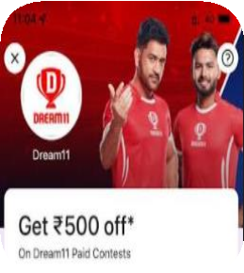
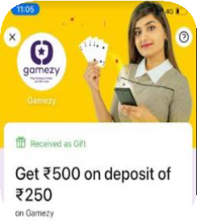
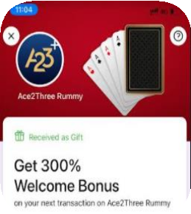
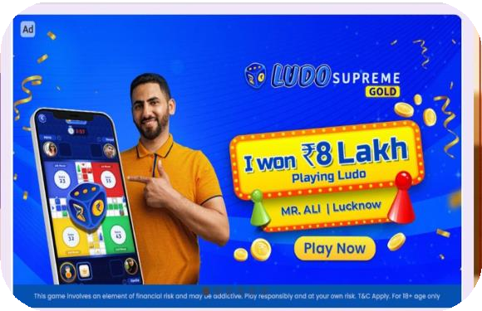
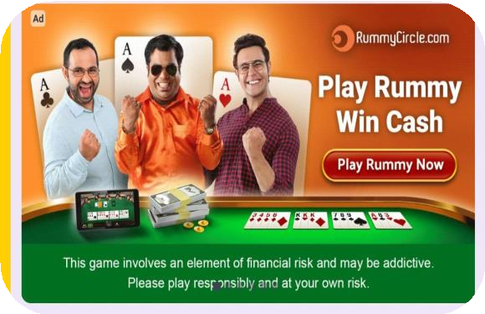
Gaming
Rewards Case Studies
Display Case Studies
Objectives
Impact
Objectives
Impact
★ First time depositors
★
★ CPD - INR 1500-2500
★
★ App Installs
★
★ CPI - INR 30-50
★
Higher ARPU users
ARPU - Rummy - INR 1100,
Reach & Traffic during
Impact traffic - 5-10 lakhs
Fantasy - INR 150
tournament
daily

Slide 8
India’s leading D2C Brands PhonePe drives the digital journey of all top brands in the sector for various Marketing Objectives
Brand Objectives
Impact Delivered
★ New user acquisition
★ Sales season amplification
★ Tier-2 & 3 market penetration
ROI - 3X-4X
ROI - 3X-4X
Target Audience - 50 Mn
★ Fashion & Footwear Online Shoppers
★ Personal Care & Beauty Spenders
★ Online Lifestyle users with OTT Subscriptions & Online daily needs & grocery spends
Conversion - 0.6-
0.8%
ROAS - 4X
29

Slide 9
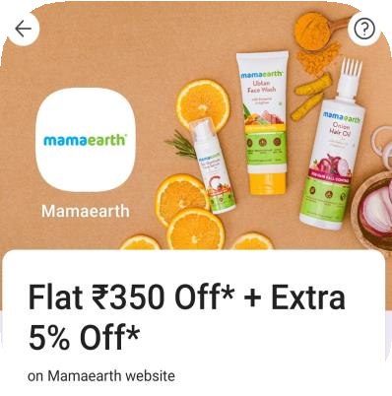
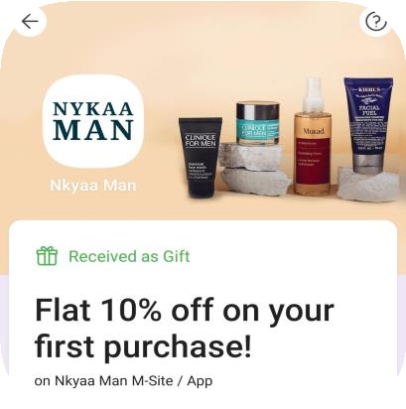
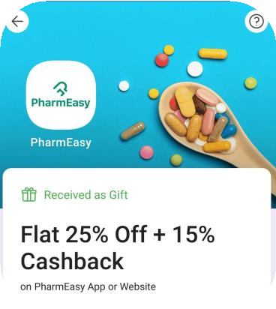
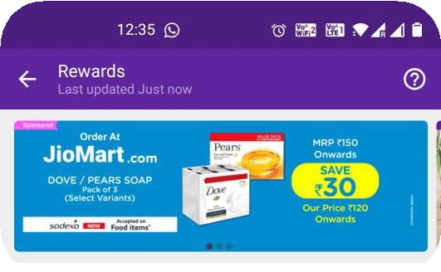
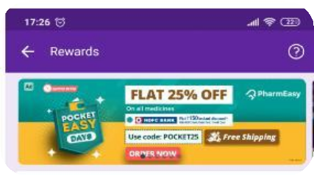
Rewards Case Studies -
D2C
Display Case Studies -
Objectives
Impact
Objectives
Impact
★ Drive New User
★ ROI - 5X-8X
★
★ Drive traffic for Sale
★ 200Mn+ impressions per
Acquisition
CTR - 5%-10%
campaign
brand monthly
★ GMV Maximization
★ Build recall for impact
★ CTR - 0.7%-1.5%
campaign

