Slide 1
Brand Lift study - Vicks

Slide 2
RESEARCH BACKGROUND
CAMPAIGN BACKGROUND
P&G for its brand “Vicks Cough Drops” launched an Ad Campaign for Cough Lozenges
“Vicks Cough Drops” with a tagline ‘Quick Relief from khich khich / sore throat irritation’.
With the motto ‘Khich Khich Door Karo’ Vicks Cough Drops is encouraging customers to pop Vicks Cough Drops and enjoy how one drop relieves khich khich and lets you carry on with your big plans for the day. The new campaign highlights Vicks Cough Drops – Nayi Tulsi Goli puts a stop before the minor irritation explodes into a major sore throat.
RESEARCH BACKGROUND
Nielsen Digital Ad Effectiveness report aims to evaluate the campaign in terms of impact on Show KPIs and ad diagnostics using a standard control v/s exposed methodology
2

Slide 3
KEY METRICS
BRAND KPI’S - Awareness, Purchase Intent, Brand Imagery
Questions asked:
When thinking about Cough Lozenges which of these brands are you aware of?
The next time you are looking to purchase Cough Lozenges, how likely or unlikely are you to purchase the following brands?
Please indicate whether you Agree or Disagree with the following statements about Vicks Cough Drops.
Imagery Statements Evaluated:
Gives Relief from Minor Throat Irritation (Khich Khich)
Comes in New Tulsi Flavour
AD DIAGNOSTICS - Ad Recall, Brand Association & Message Association
Questions asked:
Do you remember hearing any of these advertisements online?
Which brand sponsored previously heard advertisements?
With which of the following brands do you associate the message “Quick Relief from khich khich / sore throat irritation”?
List of Competition Cough Lozenges Brands evaluated for Purchase Intention & Brand Association: Strepsils, Cofsils, Dabur Honitus & Halls
3

Slide 4
THE METHODOLOGY
Brand KPIs & Communication measured among Control and Exposed set identified on JioSaavn
Total Sample Achieved: 383
Control set
Users to whom the ads were NOT served
Exposed set
Those who have been exposed to the Ad
4

Slide 5
THE DEMOGRAPHICS
Gender
Control
Exposed
34%34%
28% 28%
Campaign Target Group:
Persons 18 - 44
21% 21%
12% 12%
4% 4%
2% 2%
Male 18 - 24
Male 25 - 34
Male 35 - 44
Female 18 - 24 Female 25 - 34 Female 35 - 44
Base - 383
Data has been weighted on respondents: Age & Gender
5

Slide 6
BRAND KPIs
Awareness | Purchase Intention | Brand Imagery

Slide 7
BRAND AWARENESS
An uplift of 3% seen in the Awareness of Vick Cough Drops among the Exposed cluster when compared to Control cluster. This performance was in the Third Quintile when compared with JioSaavn Specific DAE Norms.
+3%
60%
63%
Control
Base (All respondents.) : 191
Exposed
Base (All respondents.) : 192
Nielsen Digital Ad Effect Norms - Awareness
Overall
JioSaavn Specific
Bottom Quintile | Second Quintile | Third. Quintile | Fourth Quintile | Top Quintile
Significantly higher than control @ 95% CI Significantly higher than control @ 90% CI
When thinking about Cough Lozenges which of these brands are you aware of?
7

Slide 8
PURCHASE INTENTION
Post exposure to the creative, the intention to purchase Vicks Cough Drops among those aware of Vicks Cough Drops had an uplift of 9% & falls under Fourth Quintile when compared with JioSaavn Specific DAE Norms.
+9%
68%
59%
TOP 2 BOX
Control
Base (All aware about Vicks Cough Drops.) : 115
Exposed
Base (All aware about Vicks Cough Drops.) : 119
Nielsen Digital Ad Effect Norms – Purchase Intention
Overall JioSaavn Specific
Bottom Quintile | Second Quintile | Third Quintile | Fourth Quintile | Top Quintile
The next time you are looking to purchase Cough Lozenges, how likely or unlikely are you to purchase the following brands?
Top 2 Box: Extremely Likely + Somewhat Likely
Significantly higher than control @ 95% CI Significantly higher than control @ 90% CI
8

Slide 9
BRAND IMAGERY
Amongst those who are aware of Vicks Cough Drops, significant uplift seen in the scores across all the brand imagery statements.
Statement 1: Gives relief from minor throat irritation (khich khich) Statement 2: Comes in new Tulsi Flavour
Among those Aware of Vicks Cough Drops
+10%
+19%
79%
81%
69%
62%
Gives relief from minor throat irritation (khich khich)
Comes in a new Tulsi flavour
Control (Those Aware of Vicks Cough Drops) 115
Exposed (Those Aware of Vicks Cough Drops) 121
Please indicate whether you Agree or Disagree with the following statements about Vicks Cough Drops. Top 2 Box: Strongly Agree + Somewhat Agree
Significantly higher than control @ 95% CI Significantly higher than control @ 90% CI
9

Slide 10
AD DIAGNOSTICS
Ad Recall | Brand Association | Message Association

Slide 11
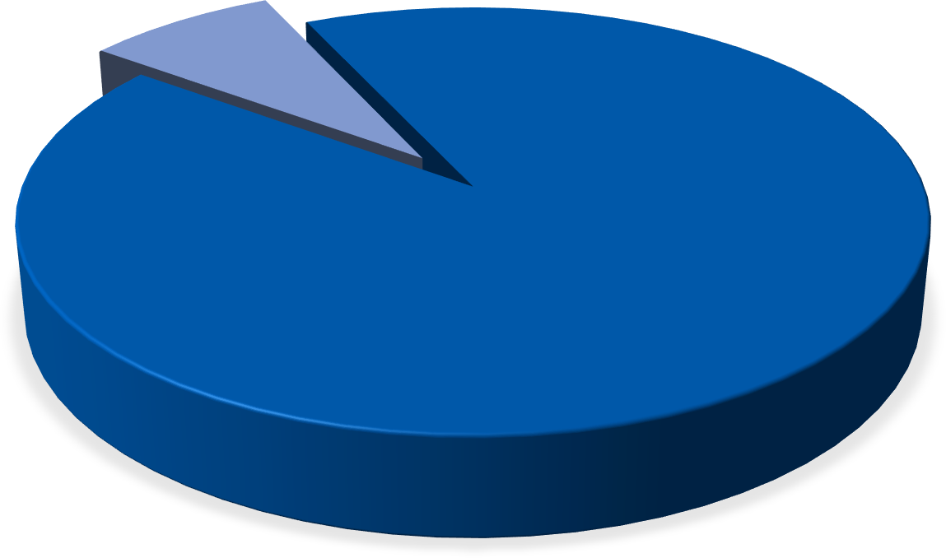
AD RECALL
92% of respondents among the exposed group recalled hearing the Vicks Cough Drops Audio on JioSaavn with Top Quintile performance when compared with Nielsen DAE FMCG Norms.
Do not Recall 8%
Recall the ad 92%
Recall the ad Do not Recall
Base (Exposed): 192
Nielsen Digital Ad Effect Norms – Ad Recall
Overall
Bottom Quintile | Second Quintile. | Third Quintile | Fourth Quintile | Top Quintile
Do you remember hearing any of these advertisements online?
14

Slide 12
BRAND ASSOCIATION
Among those who recalled the ad, 53% of respondents associated Vicks Cough Drops Audio with the Brand and falls under Third Quintile performance as per Nielsen DAE FMCG Norms.
Vicks Cough Drops
53%
Strepsils
10%
Dabur Honitus
10%
Cofsils
6%
Halls
1%
None of these
20%
Exposed : Base (Those who recalled seeing the Ad.): 177
Nielsen Digital Ad Effect FMCG Norms – Brand Association
Bottom Quintile | Second Quintile. | Third Quintile | Fourth Quintile | Top Quintile
You indicated that you remember hearing the previously shown advertisement. Which brand sponsored the previously
heard advertisements?
15

Slide 13
MESSAGE ASSOCIATION
Just like Brand Association more than half of the respondents were able to associate the message “Quick Relief from khich khich / sore throat irritation” with the brand. Message Association is ~90% among those who correctly associated the brand to the ad.
Vicks Cough Drops
53%
Vicks Cough Drops
89%
Strepsils
16%
Strepsils
6%
Cofsils
10%
^{Cofsils} 4%
Dabur Honitus
7%
Dabur Honitus
0%
Halls
1%
Halls
0%
None of these
14%
None of these
1%
Exposed : Base (Those who recalled seeing the Ad.): 177
Exposed : Base (Ad Recall & Correct Association ): 94
With which of the following brands do you associate the message “Quick Relief from khich khich / sore throat irritation”?
16

Slide 14
SUMMARY

Slide 15
SUMMARY
Nielsen Digital Ad Effect Norms
Bottom Quintile
Second Quintile.
Third Quintile
Fourth Quintile
Top Quintile
 | Lifts - Overall DAE Norms |  | Lifts - Jio Saavn DAE Norms |  | Significant Uplift |  | Comments
Brand Awareness |  |  |  |  | No |  | When compared to Control, no significant difference seen for the Exposed Clusters on Brand KPIs (Brand Awareness & Purchase Intention)
Purchase Intention |  |  |  |  | No
Brand Imagery | -NA- |  | -NA- |  | Yes
 |  |  |  |  |  |  | Significant uplift seen in Brand Imagery.
Ad Recall |  |  | -NA- |  | NA- |  | Performance on Ad Recall is in the Top Quintile
Brand Association |  |  | -NA- |  | NA- |  | High misattribution for the Ad is seen on Strepsils & Cofsils
Message Association | -NA- |  | -NA- |  | NA-
19

Slide 16
ANNEXURE

Slide 17
ANNEXURE
 | Gives Relief from Minor Throat Irritation (Khich Khich)
 | Control | Exposed
Strongly Agree | 31% | 48%
Somewhat Agree | 38% | 31%
Neutral | 22% | 15%
Somewhat Disagree | 2% | 0%
Strongly Disagree | 2% | 3%
Base (Those who are aware about Hershey's Dark Chocolate): | 115 | 121
 | Comes In New Tulsi Flavour
 | Control | Exposed
Strongly Agree | 29% | 63%
Somewhat Agree | 33% | 19%
Neutral | 28% | 14%
Somewhat Disagree | 3% | 1%
Strongly Disagree | 2% | 1%
Base (Those who are aware about Hershey's Dark Chocolate): | 115 | 121
19

