Slide 1
Brand Lift study – Pizza hut

Slide 2
RESEARCH BACKGROUND
CAMPAIGN BACKGROUND
Pizza Hut has launched a new Pizza range which starts retailing at an unbelievable price of INR 79 only. This pizza range is launched under a new category, “Flavor Fun Pizzas”, and comes in 5 craveable sauce flavors namely Tandoori, Schezwan, Italian, Cheesy and Garlic
The campaign was launched keeping the younger audience in mind. With “Flavor Fun” the brand is offering ‘more for less’, to young customers so that they can avail the service frequently and at affordable prices
RESEARCH BACKGROUND
Nielsen Digital Ad Effectiveness report aims to evaluate the campaign in terms of impact on Show KPIs and ad diagnostics using a standard control v/s exposed methodology
2

Slide 3
KEY METRICS
BRAND KPI’S - Awareness, Purchase Intent
Questions asked:
When thinking about Quick Service Restaurants which of these brands are you aware of?
The next time you are looking to visit/order from a Quick Service Restaurant, how likely or unlikely are you to purchase the following brands?
AD DIAGNOSTICS - Ad Recall, Brand Association & Message Association
Questions asked:
Do you remember seeing/hearing any of these advertisements online?
Which brand sponsored previously shown advertisements?
With which of the following brands do you associate the message “Flavour fun starting at Rs 79”?
List of Competition Quick Service Restaurants evaluated for Purchase Intention & Brand Association: Domino’s, Ovenstory, KFC
3

Slide 4
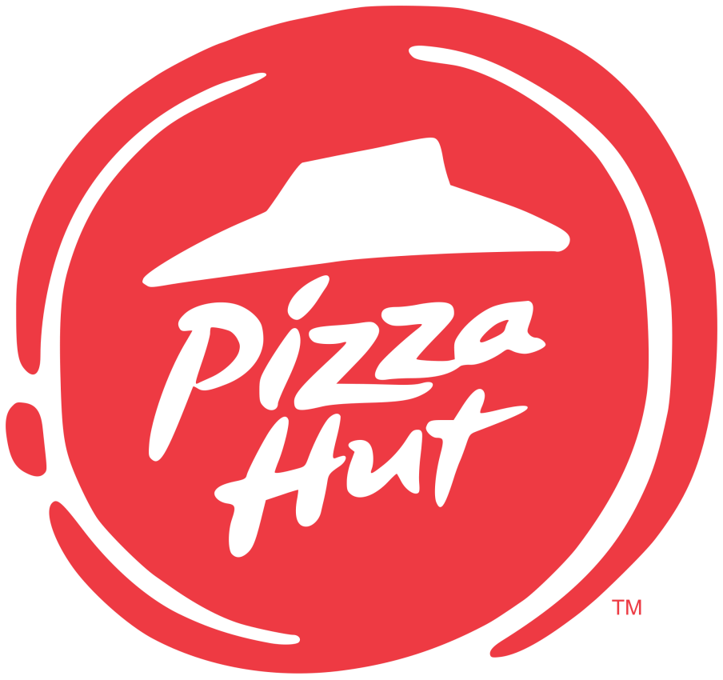
THE METHODOLOGY
Brand KPIs & Communication measured among Control and Exposed set identified on JioSaavn
Total Sample Achieved: 305
Control set
Users to whom the ads were NOT served
Exposed set
Those who have been exposed to the Ad
4

Slide 5
THE DEMOGRAPHICS
Gender
42%
42%
Control
Exposed
33%
33%
Campaign Target Group:
Persons 18 - 34
14%
14%
11%
11%
Male 18 - 24
Male 24 - 34
Female 18 - 24
Female 24 - 34
Base - 305
Data has been weighted on respondents: Age & Gender
5

Slide 6
BRAND KPIs
Brand Awareness | Purchase Intention

Slide 7
BRAND AWARENESS
A directional uplift of 6% is seen in the Awareness of Pizza Hut among the Exposed cluster when compared to Control cluster. This performance was in the Fourth Quintile when compared with JioSaavn Specific DAE Norms.
+6%
52%
46%
Control
Base (All respondents) : 152
Exposed
Base (All respondents) : 153
Nielsen Digital Ad Effect Overall Norms - Awareness
Overall
JioSaavn Specific
Bottom Quintile | Second Quintile | Third. Quintile | Fourth Quintile | Top Quintile
When thinking about Quick Service Restaurants which of these brands are you aware of?
Significantly higher than control @ 95% CI Significantly higher than control @ 90% CI
7

Slide 8
PURCHASE INTENTION
Post exposure to the creative, the intention to purchase Pizza Hut among those aware of Pizza Hut had a significant uplift of 16% at 95% CI & falls under Top Quintile when compared with JioSaavn Specific DAE Norms.
+16%
73%
57%
TOP 2 BOX
Control
Base (All aware about Pizza Hut) : 70
Exposed
Base (All aware about Pizza Hut) : 80
Nielsen Digital Ad Effect Overall Norms - Awareness
Overall
JioSaavn Specific
Bottom Quintile | Second Quintile | Third. Quintile | Fourth Quintile | Top Quintile
The next time you are looking to visit/order from a Quick Service Restaurant, how likely or unlikely are you to purchase the following brands?
Top 2 Box: Extremely Likely + Somewhat Likely
Significantly higher than control @ 95% CI Significantly higher than control @ 90% CI
8

Slide 9
AD DIAGNOSTICS
Ad Recall | Brand Association | Message Association

Slide 10
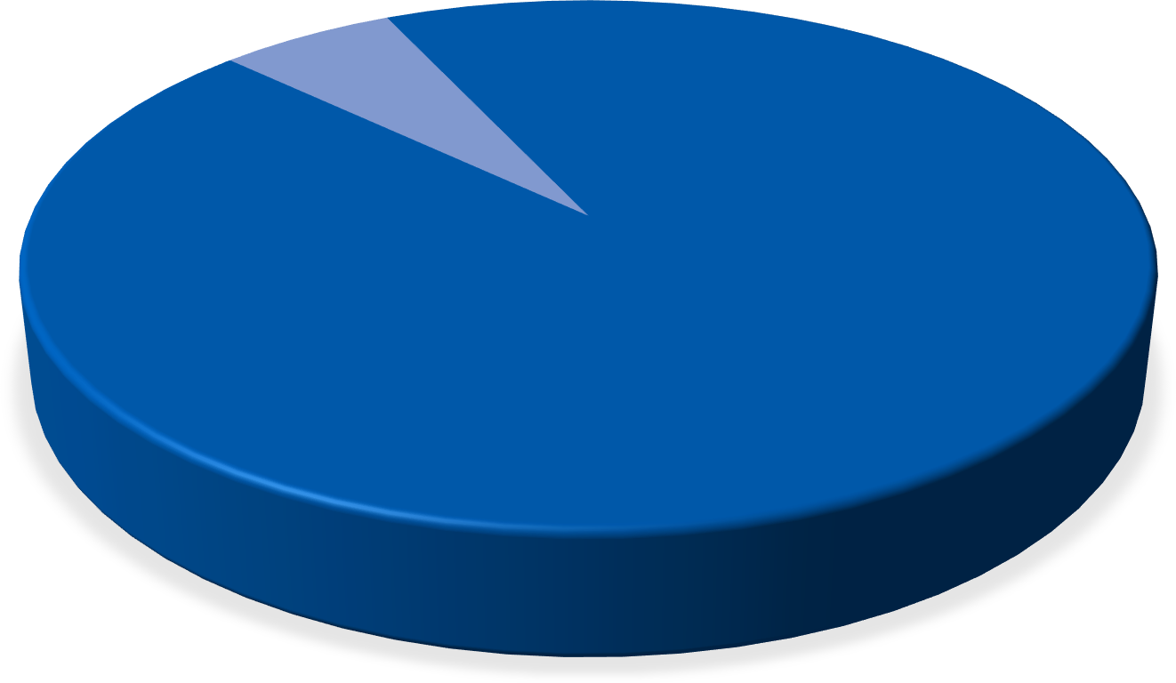
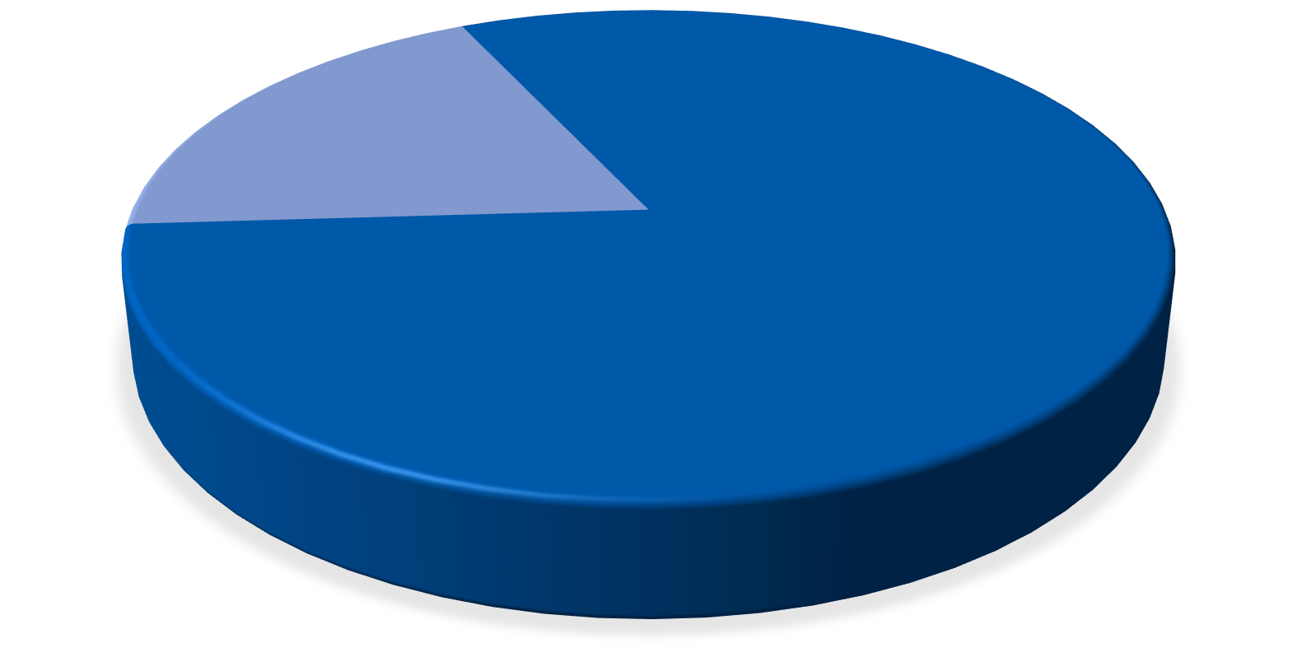
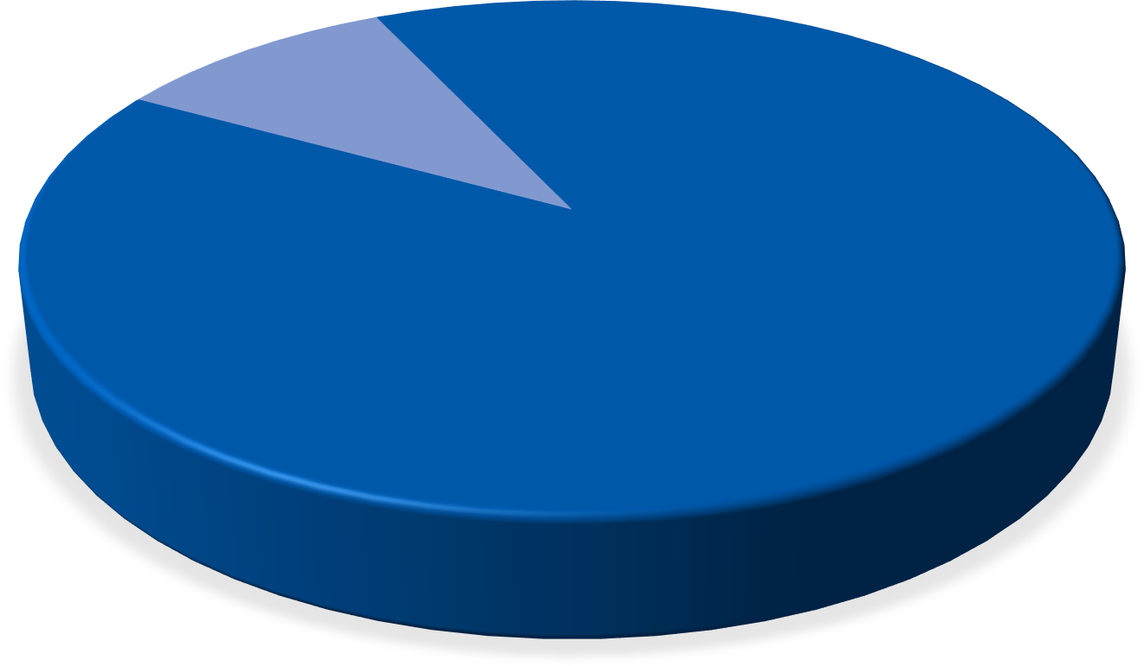
AD RECALL
94% of respondents among the exposed group recalled seeing or hearing the Pizza Hut ad on JioSaavn with Top Quintile performance as per Nielsen DAE Overall Norms
6%
19%
10%
94%
81%
90%
Recall the ad
Recall the ad
Recall the ad
Base (Exposed- Display or Audio): 153
Base (Exposed- Display): 153
Base (Exposed-Audio): 153
Nielsen Digital Ad Effect Overall Norms – Ad Recall
Nielsen Digital Ad Effect Overall Norms – Ad Recall
Nielsen Digital Ad Effect Overall Norms – Ad Recall
Overall
Overall
Overall
Bottom Quintile | Second Quintile. | Third Quintile | Fourth Quintile | Top Quintile
Bottom Quintile | Second Quintile. | Third Quintile | Fourth Quintile | Top Quintile
Bottom Quintile | Second Quintile. | Third Quintile | Fourth Quintile | Top Quintile
Do you remember seeing/hearing any of these advertisements online?
10

Slide 11
BRAND ASSOCIATION
Among those who recalled seeing or hearing the ad, 39% of respondents associated Pizza Hut ad with the Brand and falls under Second Quintile performance as per Nielsen DAE Overall Norms.
Pizza Hut |  |  |  |  | 39%
Domino's |  |  |  |  | 27%
Ovenstory |  | 2%
KFC |  |  | 10%
None of these |  |  |  | 22%
Exposed : Base (Those who recalled seeing or hearing the Ad.): 144
Nielsen Digital Ad Effect Overall Norms – Brand Association
Bottom Quintile | Second Quintile. | Third Quintile | Fourth Quintile | Top Quintile
Which brand sponsored previously shown advertisements?
11

Slide 12
MESSAGE ASSOCIATION
Just like Brand Association, 2/5th of the respondents were able to associate the message “Flavour fun starting at Rs 79” with the brand. Message
Association is ~93% among those who correctly associated the brand to the ad.
Pizza Hut
40%
Pizza Hut
93%
Domino's
27%
Domino's
5%
KFC
11%
KFC
2%
Ovenstory
3%
Ovenstory
0%
None of these
19%
None of these
0%
Exposed : Base (Those who recalled seeing or hearing the Ad.): 144
Exposed : Base (Ad Recall & Correct Association ): 58
With which of the following brands do you associate the message “Flavour fun starting at Rs 79”?
12

Slide 13
SUMMARY

Slide 14
SUMMARY
Nielsen Digital Ad Effect Norms
Bottom Quintile
Second Quintile.
Third Quintile
Fourth Quintile
Top Quintile
 | Lifts - Overall DAE Norms |  | Lifts - JioSaavn DAE Norms |  | Significant Uplift |  | Comments
Brand Awareness |  |  |  |  | No |  | No Significant difference was seen between control and exposed clusters for Awareness
Purchase Intention |  |  |  |  | Yes |  | High Purchase Intention observed among the respondents and Significant Uplift seen
Ad Recall |  |  | -NA- |  | NA- |  | Performance on Ad Recall is in the Top Quintile as per Nielsen DAE Overall Norms
Brand Association |  |  | -NA- |  | NA- |  | High misattribution for the Ad is seen on Domino’s
Message Association | -NA- |  | -NA- |  | NA-
14

Slide 15
ANNEXURE

Slide 16
ANNEXURE – BRAND AWARENESS
 | Brand Awareness
 | Control | Exposed
Pizza Hut | 46% | 52%
Domino’s | 75% | 71%
Ovenstory | 23% | 17%
KFC | 62% | 57%
None of These | - | -
Base (All respondents): | 152 | 153
When thinking about Quick Service Restaurants which of these brands are you aware of?
16

