Slide 6
RR KABEL
28th Jan to 28th Feb 2021

Slide 7
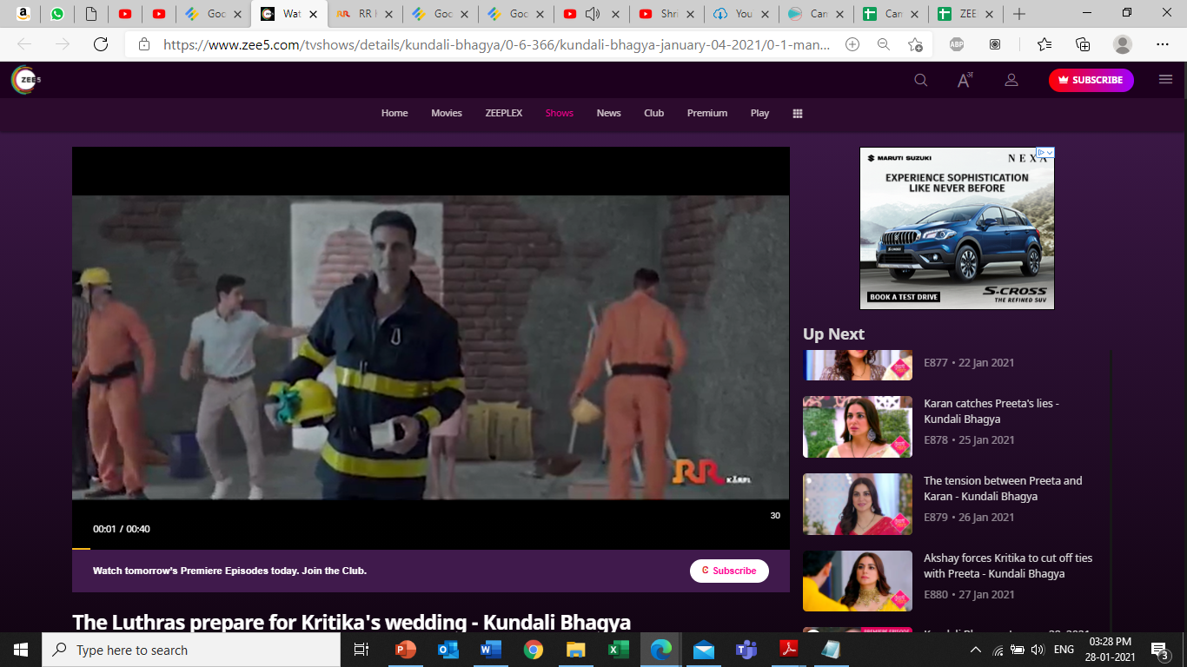

Slide 8
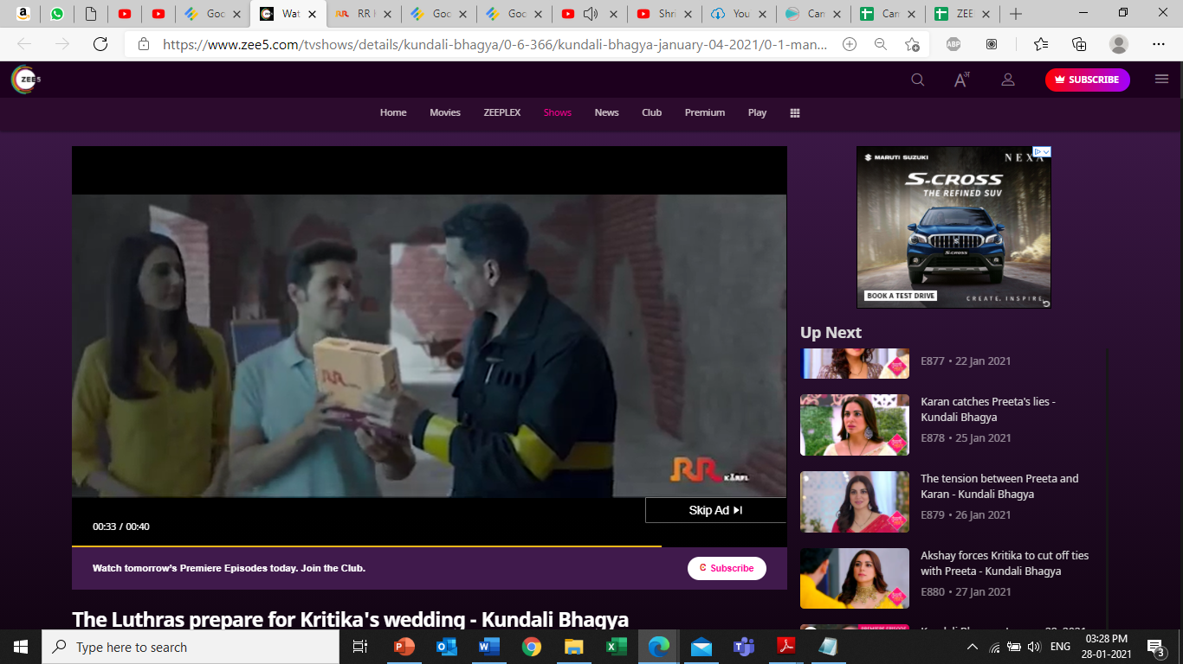

Slide 10
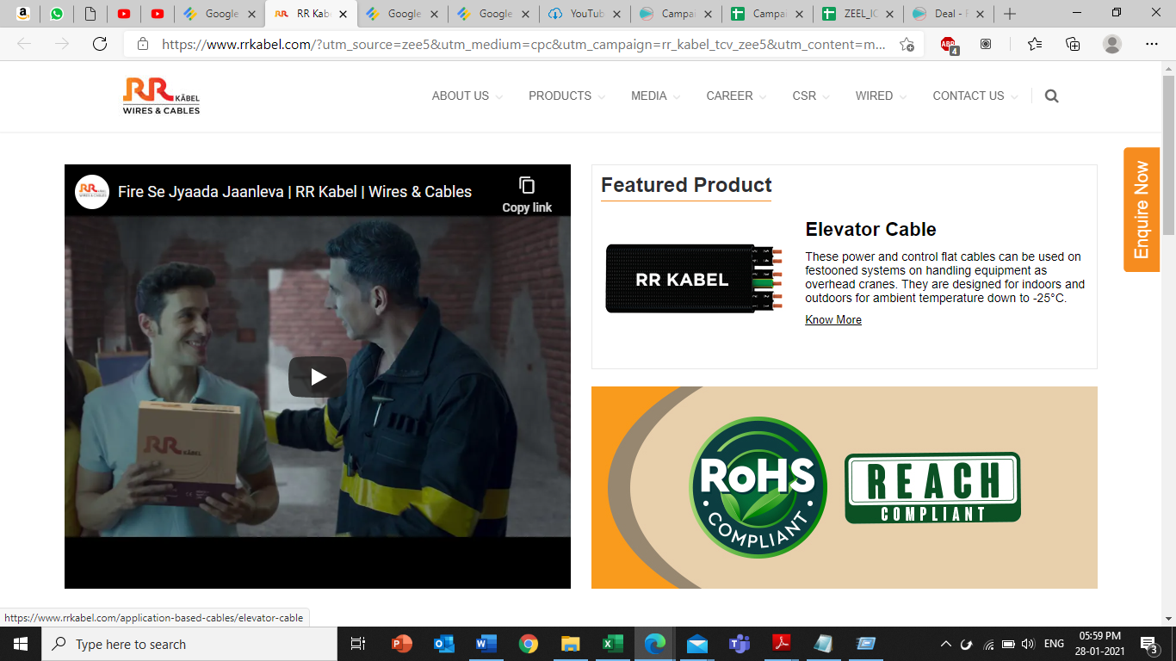
Landing Page

