Slide 1
NMMT AC BUS IMAGES

Slide 2
NMMT 9 METER ELECTRIC BUS
Bus Images

Slide 3
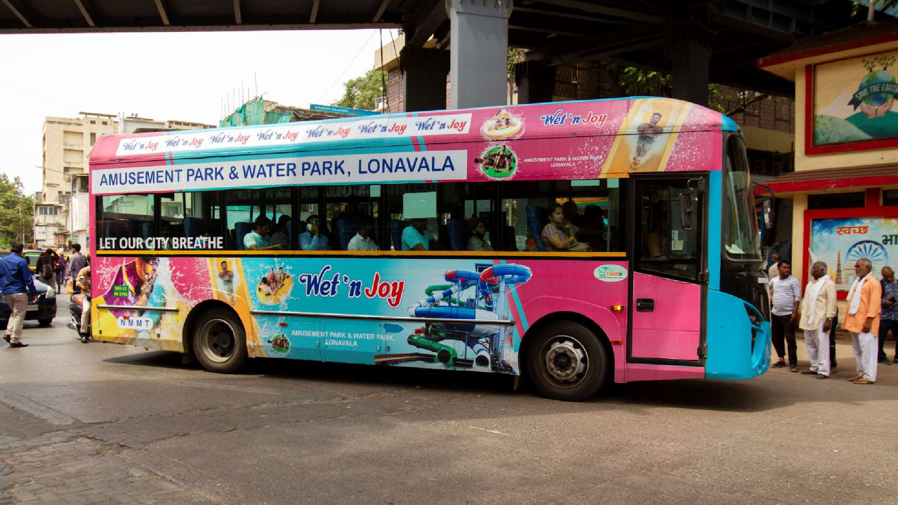
DRIVER SIDE

Slide 4
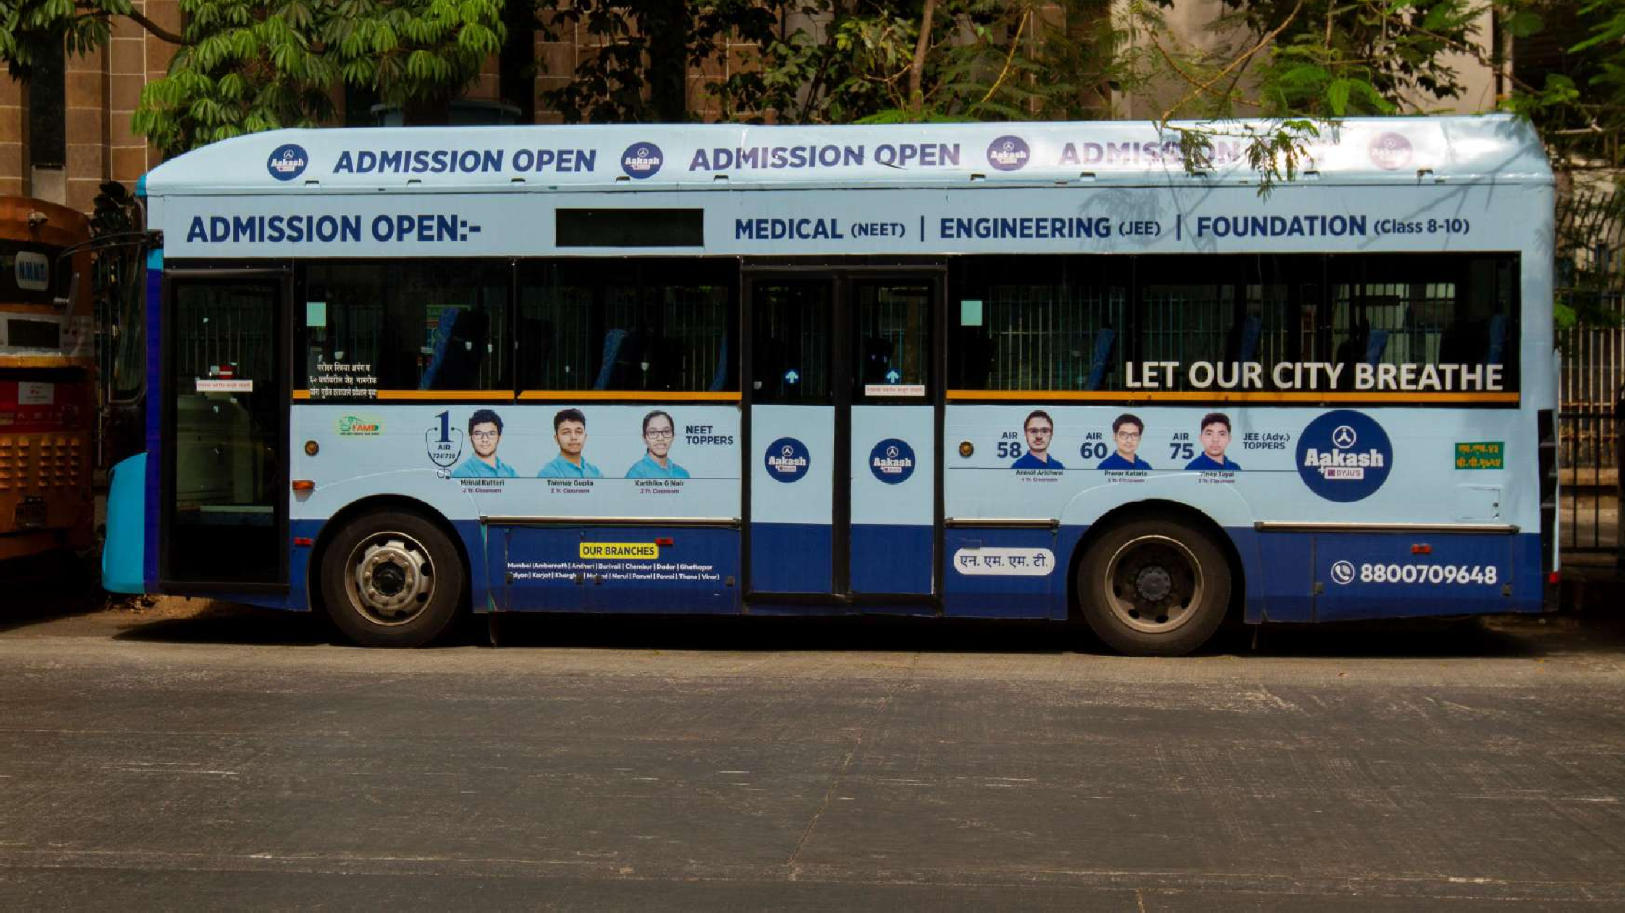
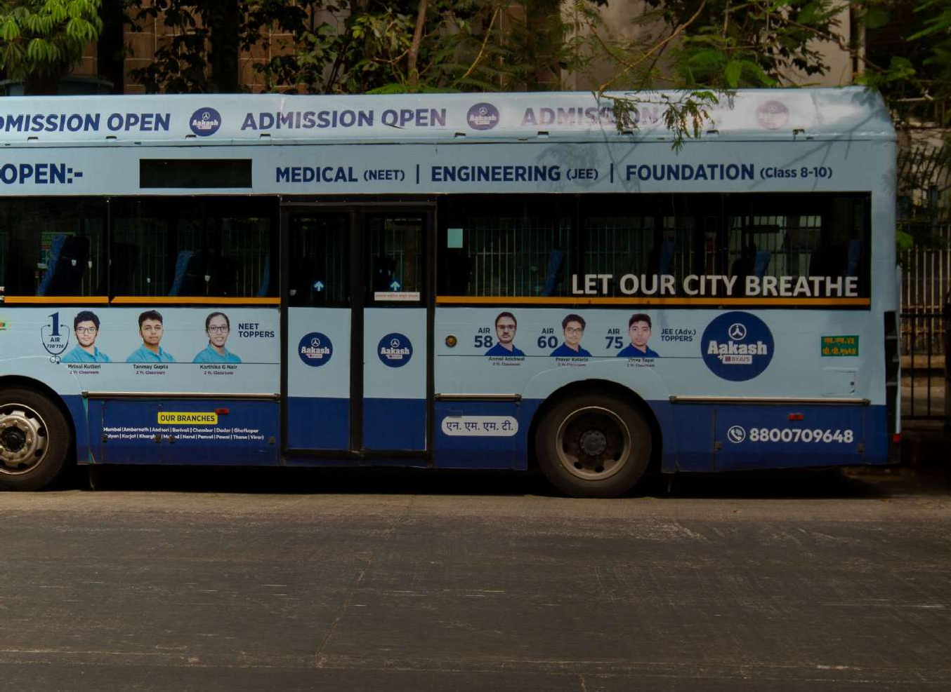
CONDUCTOR SIDE

Slide 5
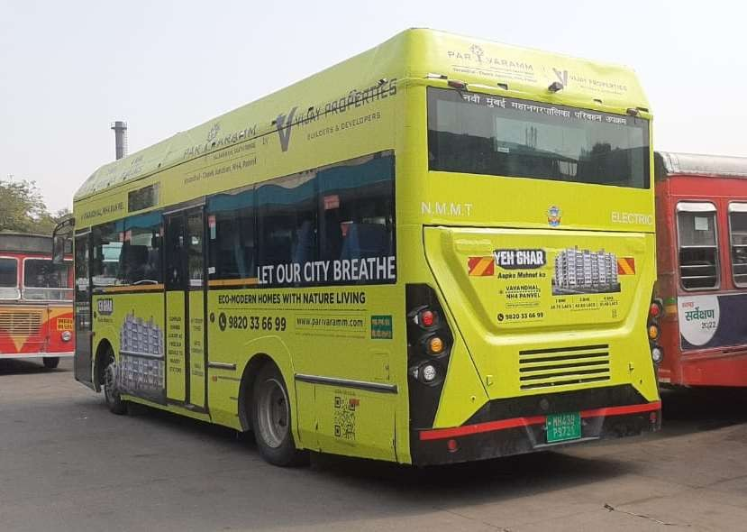
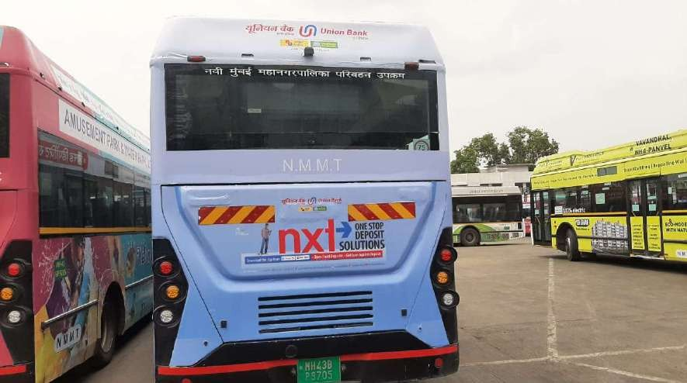
BACK PANEL

Slide 6
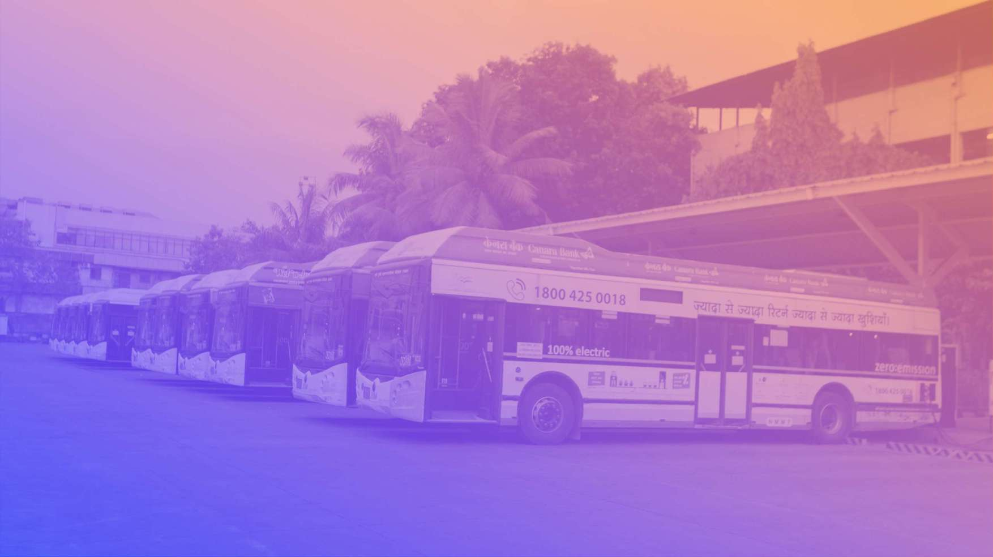
NMMT 12 METER ELECTRIC BUS
Bus Images

Slide 7
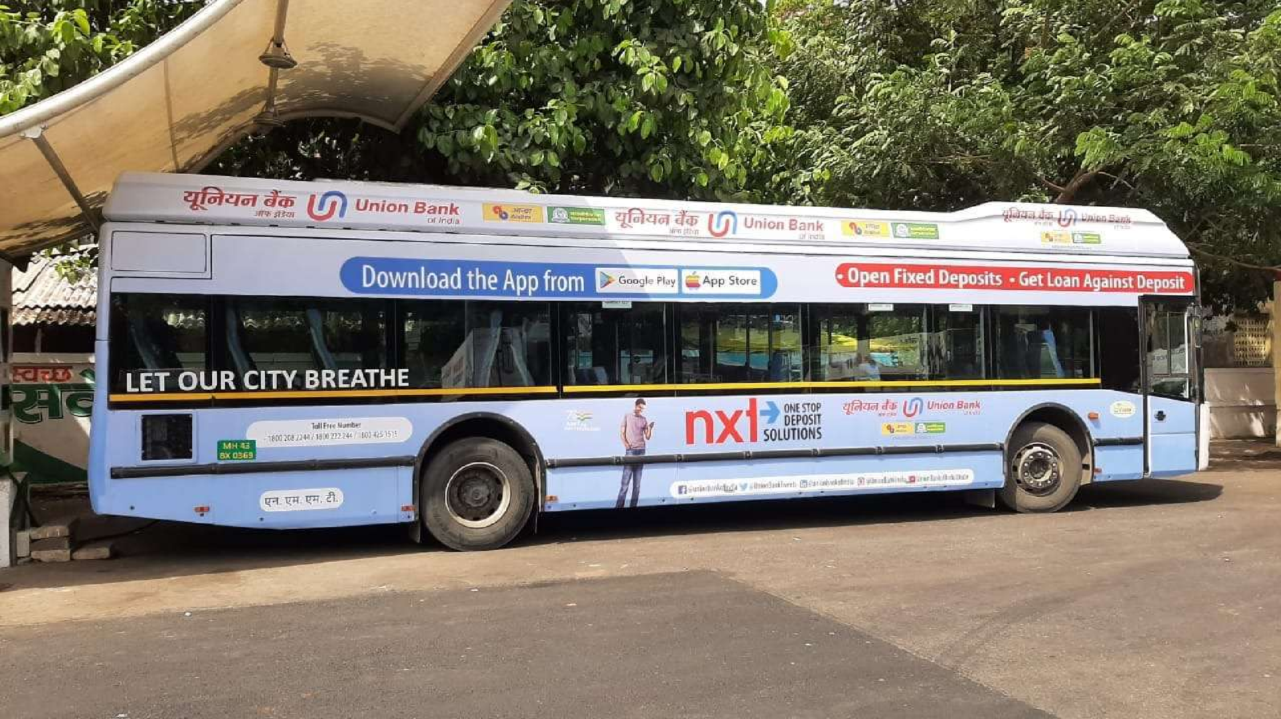
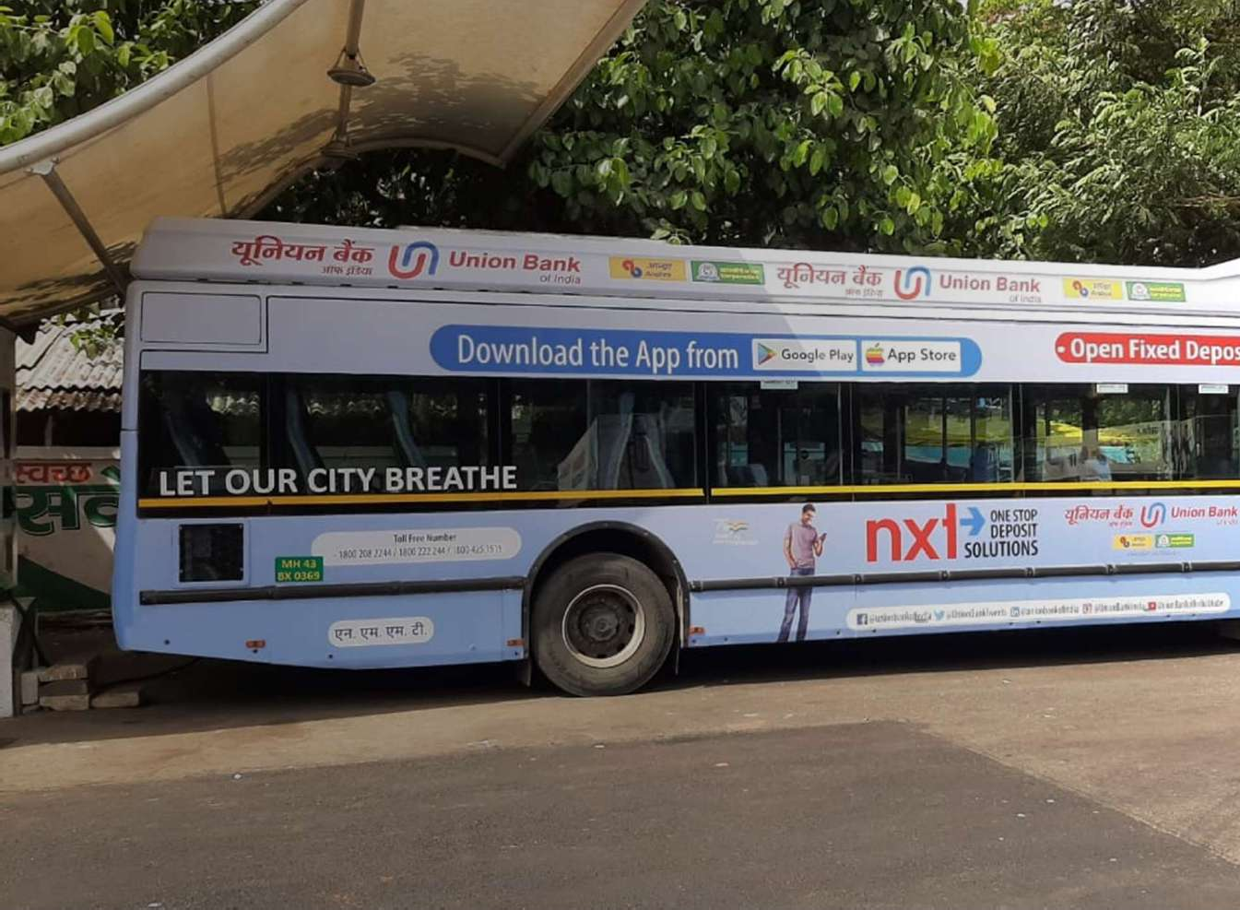
DRIVER SIDE

Slide 8
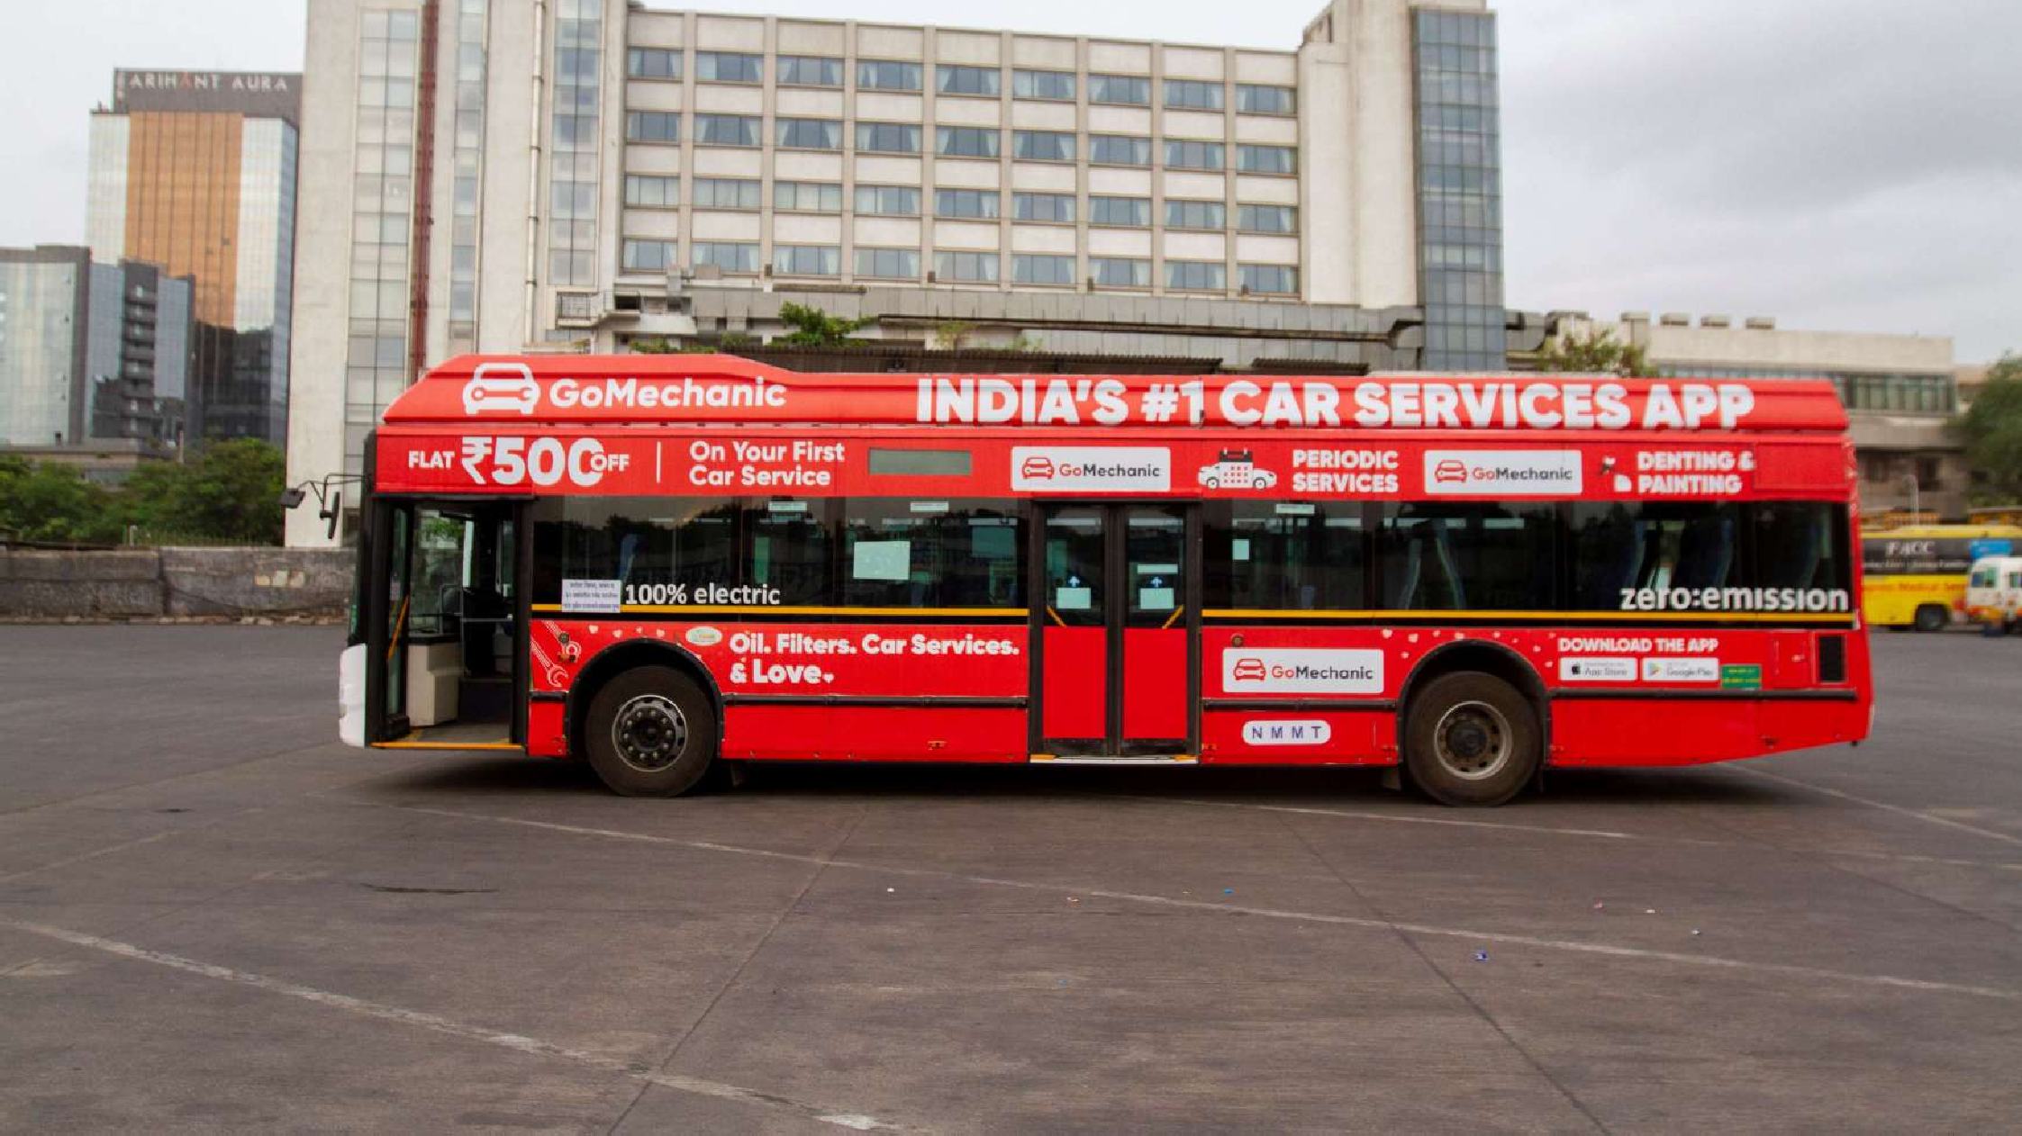
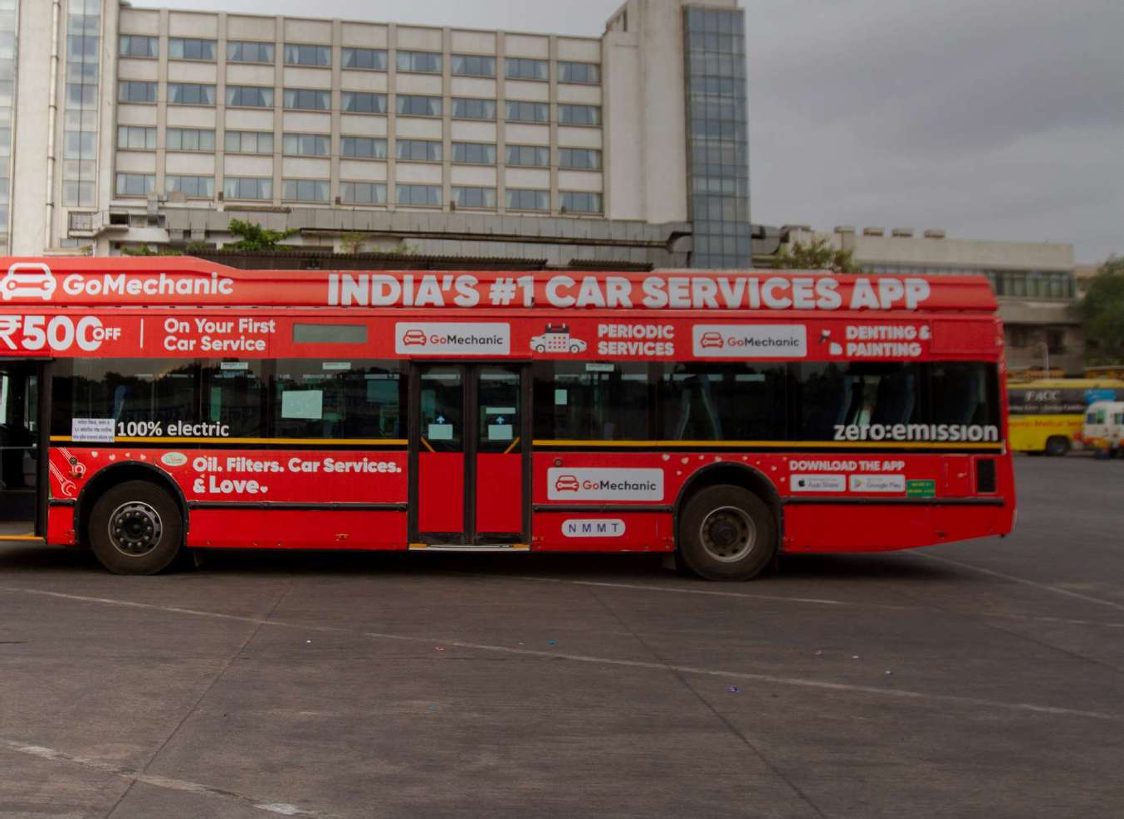
CONDUCTOR SIDE

Slide 9
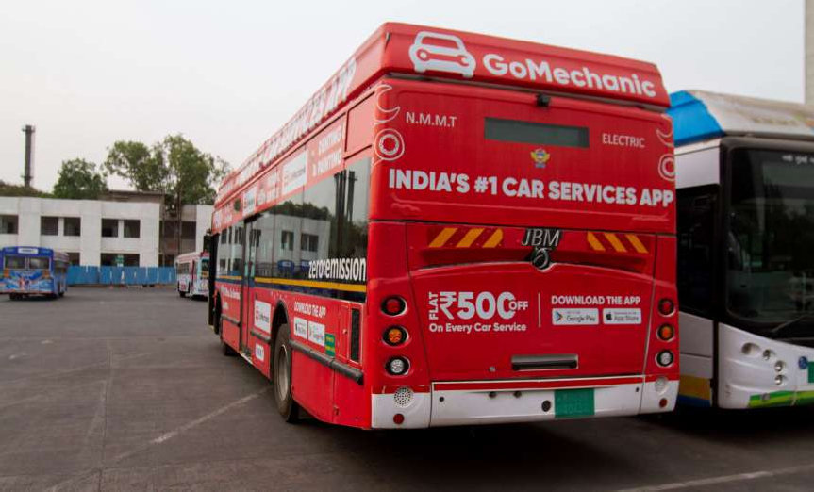
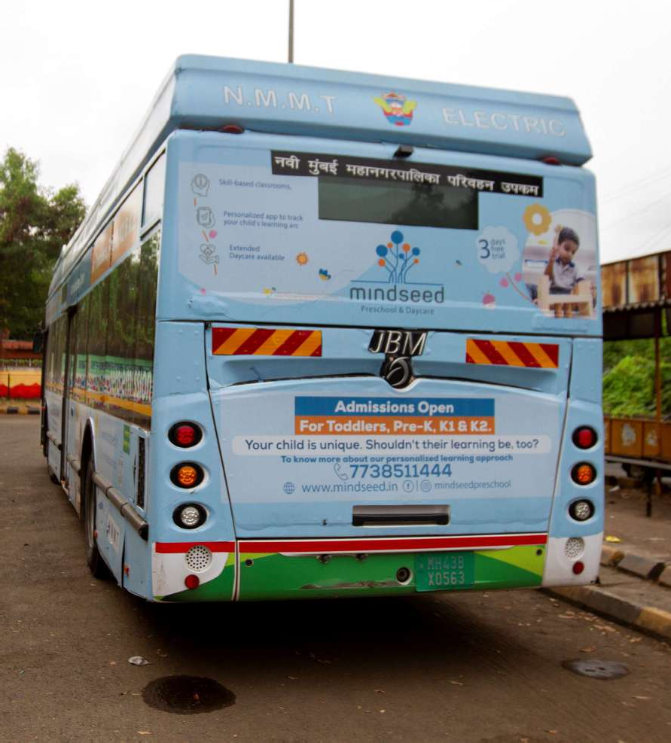
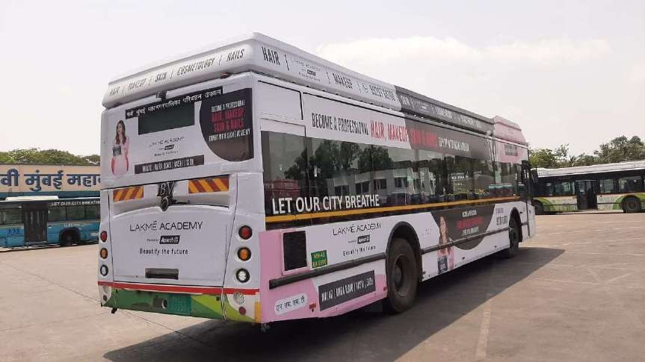
BACK PANEL
BACK PANEL

Slide 11
NMMT AC VOLVO
Bus Images

Slide 12
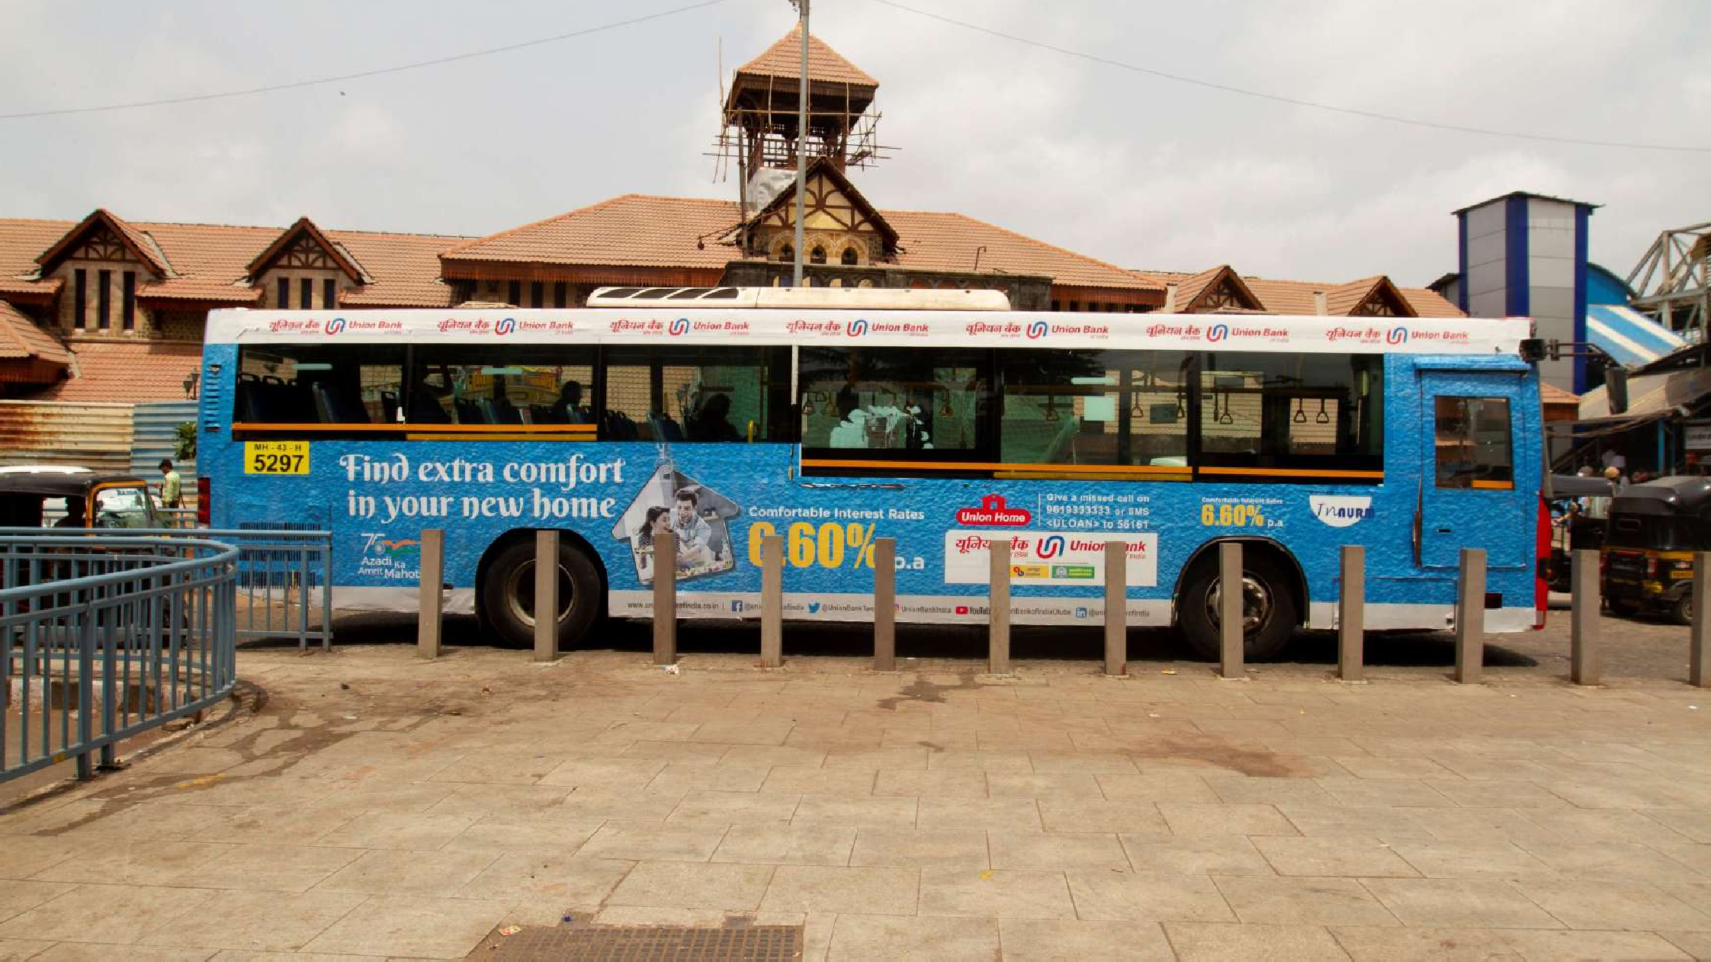
DRIVER SIDE

Slide 13
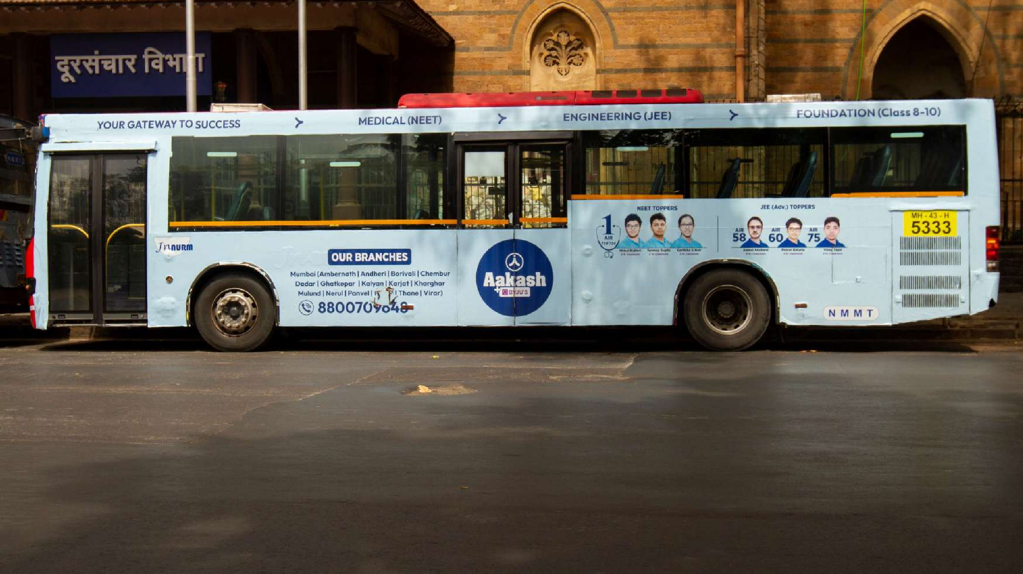
CONDUCTOR SIDE

Slide 14
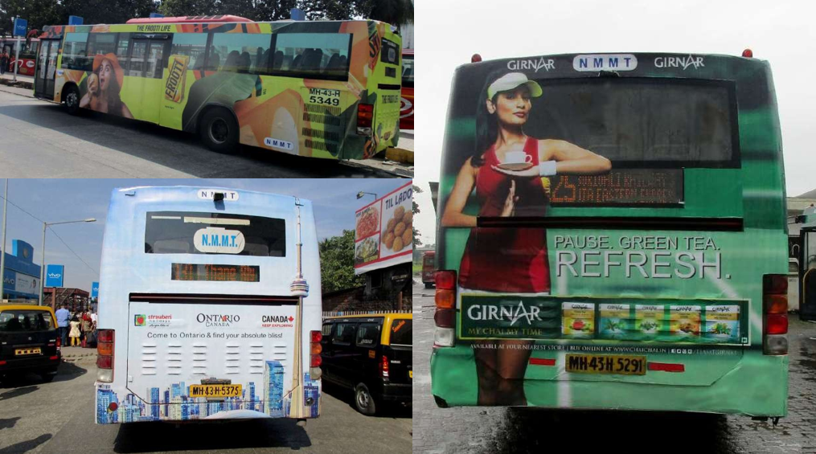
BACK PANEL
BACK PANEL

Slide 15
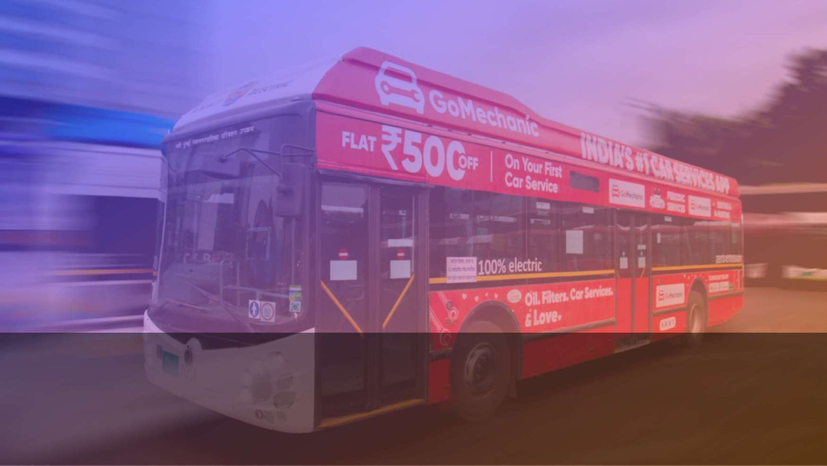
100% Electric Bus
No Heat + No Emissions + No Vibrations = No Vinyl Damage

