Slide 1
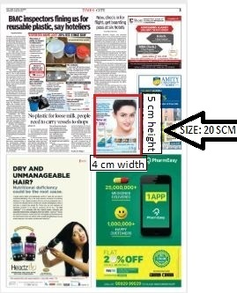
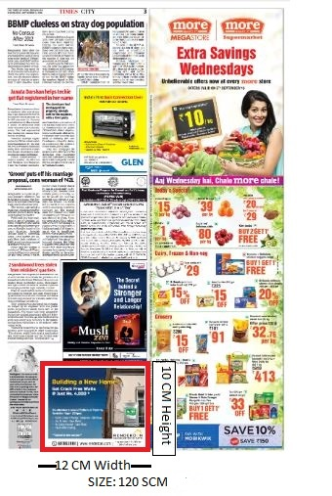
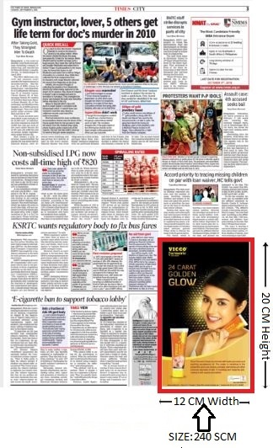
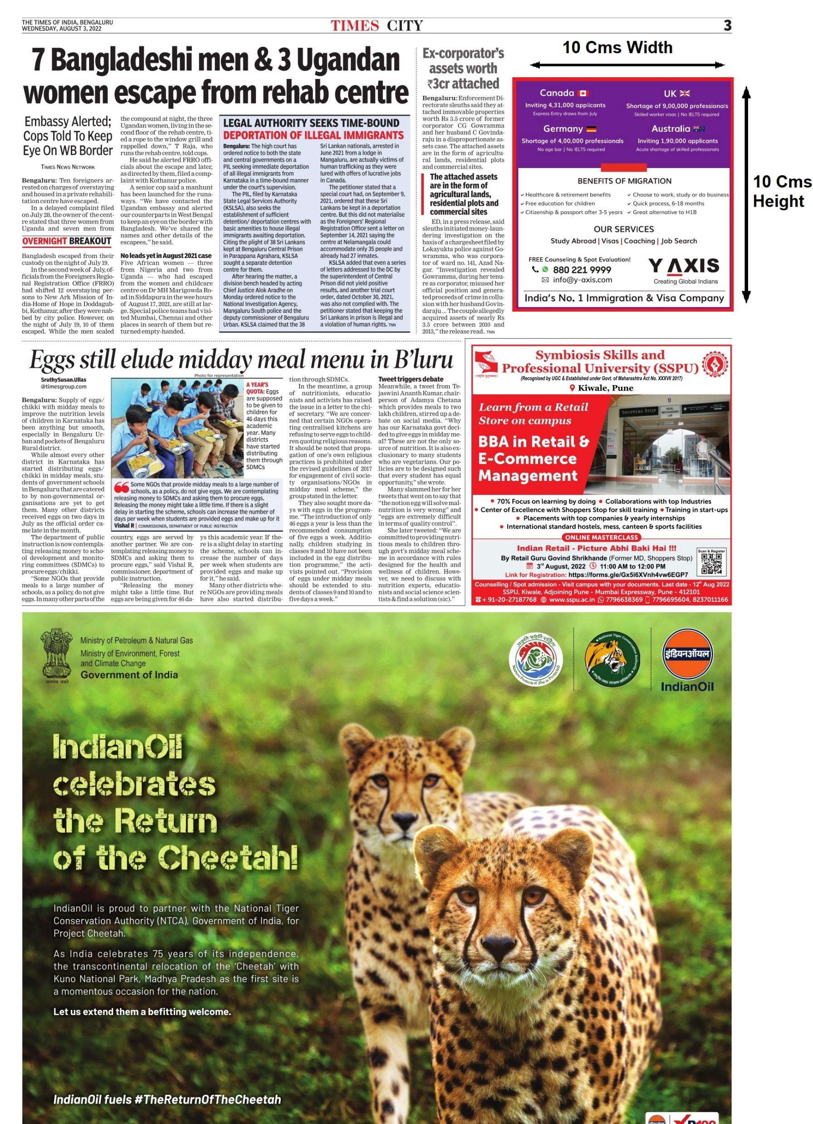
Popular Custom Sized Dimensions
4 Width X 5 Height
12 Width X 10 Height
12 Width X 20 Height
10 Width X 10 Height
Area: 20 Sqcm
Area: 120 Sqcm
Area: 240 Sqcm
Area: 100 Sqcm

Slide 2
Possible Dimensions to Advertise in Newspaper
 |  | 120sqcm | 240sqcm | Quarter Page 400sqcm | Horizontal Half Page 825sqcm | Vertical Half Page 736sqcm
S.N | Particulars | W H | W H | W H | W H | W H
1 | Popular | 12 10 | 12 20 | 20 20 | 32.9 25 | 16 46
2 | Popular | 10 12 | 20 12 | 16 25 | NA | NA
3 | Other alternative | 03 40 | 15 16 | 25 16 | NA | NA
4 | Other alternative | 05 24 | 16 15 | 08 50 | NA | NA
5 | Other alternative | 24 05 | 05 48 | 10 40 | NA | NA
6 | Other alternative | 06 20 | 06 40 | NA | NA | NA
7 | Other alternative | 20 06 | 08 30 | NA | NA | NA
8 | Other alternative | 08 15 | 30 08 | NA | NA | NA
9 | Other alternative | 15 08 | 10 24 | NA | NA | NA
10 | Other alternative | 04 30 | 24 10 | NA | NA | NA
11 | Other alternative | 30 04 | - | - | - | -
Note: Other alternatives dimensions are not a popular dimensions and subject to approval from the respective publication

