Slide 1
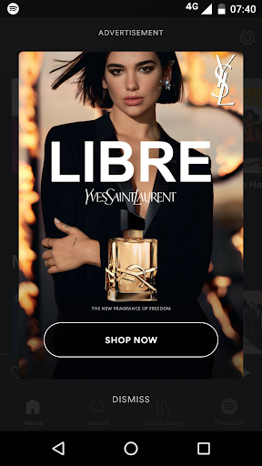
YSL on Spotify
Brand: Yves Saint Laurent
Objective: YSL partnered with Dua Lipa to launch a new fragrance called ‘Libre’, as a part of the campaign, the brand created video & banner ads that used Dua Lipa & her music to create awareness for the fragrance amongst highly affined & affluential female audience on premium ad platforms like Spotify. The goal was to drive awareness for the launch of the new fragrance amongst their core TG,
Targeting: Females, 25-45, Top Metros, Streamers of Pop, EDM, House Music, Concert Goers, Premium Device Users etc.
Creative Concept: We deployed video ads & banner ads targeted to the TG. Our video & banner ads are built for viewability & engagement as they target the ‘lean-in’ moment experienced by users. Tads only served when the audience is actively looking at, & engaging with the screen, hence ensuring strong visibility, recall, & engagement.
0.7%.
CTR
(higher than benchmark of 0.5%)
~ 0.4 Mn.
Reach

Slide 2
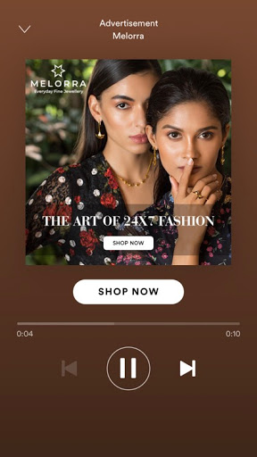
Melorra on Spotify
Brand: Melorra
Objective: To create awareness for Melorra’s range of fashion jewelry & to drive consideration for the products on e-comm amongst relevant audiences on Spotify who are premium & well engaged. The brand had a 30 sec. ad film that was to be promoted.
Targeting: Females, 18+, Top 6 Metro Cities
Solution: We deployed Sponsored Sessions as the video ad format to promote the brand film. Sponsored Session ads gratify the audience with 30 min. of ad free music after they have seen your ad, & the advertiser gets higher SoZV & better ad recall as no other brand can advertise. The ads where specifically targeted to Females & the companion banner drove them to the e-comm site for consideration.
1.9%.
CTR
~2 Mn.
Unique Users Reached
104K+
Campaign Clicks

Slide 3
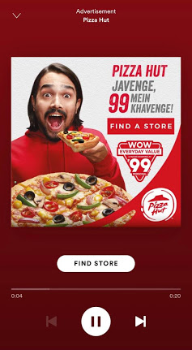
Pizza Hut India on Spotify
Brand: Pizza Hut India
Objective: To create awareness for the launch of Pizza Hut’s limited time offer of select pizzas @ Rs. 99, in store. This campaign was in line with their larger campaign with Bhuvan Bam for the Pizza Hut @ 99 promo.
Targeting: Males & Females, 18-35, Top 8 Metro Cities
Solution: We deployed our Audio Everywhere ad format for Pizza Hit India with the aim of targeting Males & Females, 18-35, with an ad that was voiced by Bhuvan Bam in a similar tone of quirk as what he used in the brand TVC. Our audio ads are served to audiences in between music. Our ads are non-skippable, served in a 1:1 format, & accompanied by a companion banner that is clickable & can take users to a desired landing page. Users would click on the banner & locate the closest store to them that was running the offer.
0.7%.
CTR
~550K
Unique Users Reached
10K+
Campaign Clicks

Slide 4
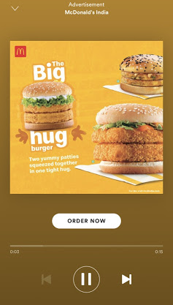
McDonalds’s India on Spotify
Brand: McDonald’s India
Objective: To create awareness for the limited range of The Big Hug range of burgers from Mcdonald’s in North India & to drive consideration for the menu item amongst relevant users during the limited period activity.
Targeting: GenZ & Millennials, Delhi NCR
Solution: We deployed our Audio Everywhere ad format for McDonald’s India with the aim of targeting GenZ & Millennials who were the core TG for the brand. Our audio ads are served to audiences in between music. Our ads are non-skippable, served in a 1:1 format, & accompanied by a companion banner that is clickable & can take users to a desired landing page. Users would hear the messaging for the special edition burgers via audio & could click on the banner to place their order. Lovin’ it!
0.4%.
Audio Ad CTR
305K
Unique Users Reached
3K+
Campaign Clicks

Slide 5
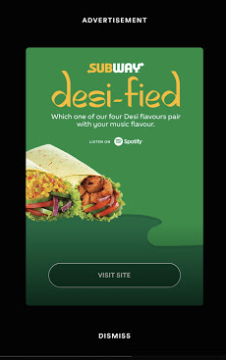
Subway India on Spotify
Brand: Subway India
Objective: To create awareness for the launch of Subway’s Desi Wraps in India & to drive consideration for the new menu item by getting audiences to learn more about the 4 new desi flavors of wraps.
Targeting: Males & Females, 18-35, Pan India
Solution: We created a custom microsite for Subway India where audiences were matched to the Desi Flavor Wrap that matched their personality, basis the music they listened to on Spotify. Our API would scan their music listening preferences/habits, & recommend a flavor for them that they would enjoy along with a playlist of the freshest desi hits to accompany their wrap at Subway!
0.7%.
CTR
~ 1.5 Mn.
Unique Users Reached
00:45 Sec
Time Spent on Site

Slide 6
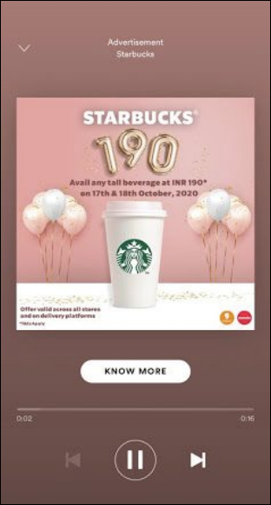
Starbucks India on Spotify
Brand: Starbucks India
Objective: To create awareness for Starbucks @ 190 as a promotional offer in October 2020 amongst relevant audiences, there by driving consideration for the coffee chain in key metro cities.
Targeting: Males & Females, 18+, Top 6 Metro Cities
Solution: We deployed our Audio Everywhere ad format for Starbucks to promote the offer. The audio ad spoke about the range of beverages, the safety & social distancing protocols, & he Starbucks @ 190 offer over a weekend in October. It also mentioned that the coffee could be ordered via partner delivery apps like Swiggy & Zomato.
0.65%.
CTR
~600K
Unique Users Reached
~7K+
Campaign Clicks

Slide 7
KFC India on Spotify
Brand: KFC India
Objective: To create awareness for KFC’s range of Boss Buckets & to drive consideration for the menu item amongst audiences on Spotify to order the bucket.
Targeting: Males & Females, 18+, Top 6 Metro Cities
Solution: We deployed our Audio Everywhere ad format for KFC India to promote the Boss Buckets menu item. The ads were quirky, & were scripted to covey that the boss bucket was for audiences who wanted to feel like a boss & enjoy a filling & sumptuous bucket of fried chicken & appetizers. Our audio ads are served to audiences in between music. Our ads are non-skippable, served in a 1:1 format, & accompanied by a companion banner that is clickable & can take users to a desired landing page.
0.5%.
CTR
~320K
Unique Users Reached
2.5K+
Campaign Clicks

